Slide 1

ACT: Accompaniment and Connection Training
Part 1: Basic Mental Health Literacy
Part 2: CMHM MODEL OF PSYCHOLOGICAL FIRST AID (PFA)
OFFERED BY:
THE INTERNATIONAL ASSOCIATION OF CATHOLIC MENTAL HEALTH MINISTERS
Notes:
0:00
1. Welcome the participants and introduce the facilitator(s).
2. Provide participants with any practical information, such as start and finish times, meal breaks, where to find washrooms, etc.
3. Explain that this is a short training in basic PFA skills, which means it does not cover topics such as how to handle complicated situations, or how to provide psychological first aid to children.
4. Explain that this is part of a larger resource offered by CMHM, and is based on Lesson 6 in the Handbook titled, “Basic Mental Health Literacy for Accompaniment & Psychological First Aid”.
Say that “PFA is becoming increasingly popular and recognized more and more as an effective way of helping people in distress all over the world. Different models are used by different organizations, but the aim of PFA is the same, to empower people with the knowledge and skills to be able to provide comfort to those in distress.
NOTE: For this presentation, it is not the intention that the facilitator will read every point on every slide.
The teaching notes for each slide will recommend which points should be reviewed for the learners (feel free to restate in your own words).
Learners will have time to read some of the other points for themselves.
Each slide’s teaching notes will include additional information that the facilitator should share with the learners (feel free to restate in your own words).

Slide 2

OBJECTIVES
01
02
03
04
05
06
Learn why PFA is beneficial for mental health ministers
Know what Psychological First Aid is and what it is not
Understand the impact of stress/distress and mental health challenges on the brain and body
Discuss the three principles of PFA: ‘Look, Listen and Link’
Practice providing PFA through sample scenarios
Self-care for the PFA helper
Notes:
Continuing explaining that the same three basic principles are used in all models of PFA training:
approaching someone in distress
assessing what help the person needs together with him or her
helping them access this help
Say, “In this training, we will learn more about and aim to practice these three principles through the action steps: ‘Look, Listen and Link.’ from the World Health Organization’s PFA resource.”
Review the 6 objectives on the slide for the participants.

Slide 3
During our time today:
Minimize distractions
Refrain from interrupting when in small group discussions
Respect one another
Try to listen with full attention and without judgement in small group discussions
Questions are welcome
Keep everything that is disclosed in the group confidential
Notes:
0:05
Explain that it is important that the group agrees on ground rules for the workshop, to create a safe environment where everyone can feel comfortable participating and sharing.
(Review the slide)
Assure participants that they do not have to participate in all activities. If they feel uncomfortable about participating in an activity, they can step back and simply observe. If anyone is feeling extremely challenged emotionally or psychology, they are invited to step out of the room to regain their equilibrium, or to let a staff person or facilitator know if they need additional assistance.

Slide 4

What is Psychological First Aid (PFA)?
Psychological First Aid (PFA) is an evidence informed approach that is built on the concept of human resilience.
PFA aims to reduce stress symptoms and assist in a healthy recovery
PFA is a set of skills that you can use to cope with distressing situations and events.
PFA
Notes:
Explain that:
1) Psychological First Aid skills involve recognizing when someone is in distress and taking action to help them. What action you take depends on the situation and what help the person needs and is likely to differ every time you help someone.
2) PFA can be offered if someone is experiencing a mental health challenge or following a stressful event such as a natural disaster.
3)You can use psychological first aid skills to deal with your own experiences and to support others who are in distress.

Slide 5
Why is it good to for MH Ministers to learn PFA?
Inpatient Services
Who do people go to for emotional (or spiritual) support?
Professionals and Paraprofessionals
These top two groups are needed and accessed by a small percentage of people.
Trained Volunteers
Many people can access and benefit from support offered by volunteers and community members, plus family and friends.
Spiritual Leaders & Faith Community
Family and Friends
Notes:
Emphasize that not everyone who experiences a mental health challenge requires professional or specialized mental health care. But that everyone can benefit from community support – including those who are receiving clinical professional care.
Review the slide for the participants
Share these other benefits of community awareness and support for MH:
1) People are more likely to seek additional support , if it is needed, if someone close to them suggests it.
2) Early intervention when someone is distressed leads to better outcomes and can help avoiding secondary negative outcomes (job loss, relationship difficulties, substance use issues, etc.)

Slide 6

How can PFA benefit our Catholic communities?
Gives the information and confidence needed so that we may:
      notice someone may be suffering and have an idea of how to respond
      offer someone the gift of our time and presence, offer accompaniment
      know when someone’s need is beyond our scope and how to potentially link someone to additional helps or supports
Notes:
Review the slide title.
Say, “In addition to the benefits listed on the slide, other benefits include:
1) The opportunity to offer someone the love of Christ
2) Knowing what our role as mental health ministers/Catholic community members is and is not
3) Knowing which level of care is appropriate for us to offer or if additional helps or supports are needed
4) These might include:
local resources to help meet basic needs
clergy and/or safety professionals
medical or mental health professionals
Share example of coming upon someone in the park with what appears to be an ankle injury. Someone offering First Aid would not try to diagnose the injury, to cast it, or to perform surgery on it. He/she might ask if the person is okay, help the person to a bench, or might call 911 for the person. PFA is similar in the case of meeting someone who is struggling with a MH challenge.

Slide 7
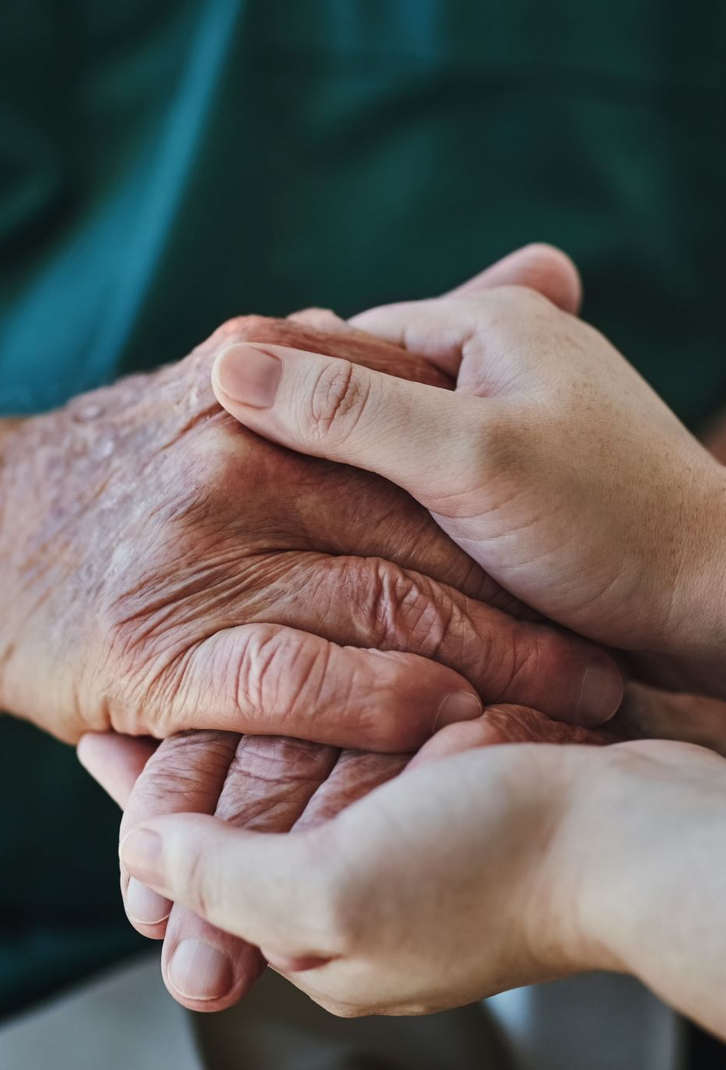
PFA can provide
Comfort
Someone to listen
Protection from further harm
Emotional and spiritual support and prayer
Information about more advanced services and support
Notes:
0:10
State that “In addition to the items on the slide, PFA can be:
Comforting someone who is in distress and helping them feel safe and calm
Listening to someone's needs and concerns
Helping to protect people from further harm
Providing emotional and spiritual support and prayer
Assisting people in accessing information or more advanced services and support”

Slide 8
PFA is not
Something only professionals do
Diagnosing or prescribing medication for treating mental illness
Professional counseling or therapy
Pressing for all the details of what has caused/is causing someone’s distress
Fixing someone’s mental illness or distress
Notes:
Review the slide for the participants.
Share another analogy with the participants, “Think of someone you know who may have been diagnosed with a rare from of cancer. They may wish to talk with us about this experience, their concerns, their fears. They may wish us to pray with them about it. Being present with them and listening to them is a great gift. They would not ask us – and we would not be tempted to – fix this cancer, diagnose this cancer, or treat this cancer. Possibly we would let them know that we know of an oncologist in our area or a Cancer treatment hospital.
In PFA we offer the same listening presence – and DO NOT offer a fix, or offer to treat, or to diagnose. Do you see the parallels?”

Slide 9

Why someone may need PFA support
Living with a mental illness
Caring for a loved one with a mental illness, or filling any caregiving role
Following a distressing event such as:
  finding out one has a serious physical illness, or losing a loved one
  being in a car or other type of accident, or experiencing a natural disaster
  being assaulted or experiencing other forms of violence, or witnessing something frightening or traumatic
Notes:
State that a person may benefit from PFA in any situation that causes someone to experience stress/distress
Highlight that distressing events can be individual and personal, for example when someone is going through a divorce or has lost a loved one. They can also be public and affect many people together, for example due to a natural or human-related disaster.
Continue by explaining, “When we experience frightening or distressing events like the ones listed on the slide, we react with our bodies, thoughts, and our feelings. This is normal. It is important to understand this.
Everyone reacts when they go through something stressful and difficult. Most people recover from difficult experiences by themselves or with the help of friends, family, or others.
Psychological First Aid involves knowing common reactions to distressing events and how to help people cope with these reactions.
Psychological First Aid can help people in distress cope better emotionally and practically, and in this way PFA helps to reduce negative impacts of distressing events. Part of Psychological First Aid is helping the affected person access social support, which can help to reduce stress and improve recovery.”

Slide 10
What is Stress?
The International Federation of the Red Cross defines stress as “A very broad term referring to the effect of anything in life to which people must adjust.”
  For instance, anything we consider challenging causes stress, even if it is something we willingly choose to do.
  The key is that stress requires us to adjust our attention and behavior, and it makes demands upon our energy.
Minnesota Department of Health. (2025). Psychological First Aid: A Minnesota Community Support Model.[PowerPoint slides].
Notes:
0:15
1. Read the top bullet point for the participants
2. Ask the large group: “What are some reactions we may observe in, or learn about from, someone who is experiencing stress or distress?”
3. Let the large group offer 5-10 answers.
4. Note that chronic illness, including chronic mental illness Is different than a single, acute distressing event and that those who live with (or who care about someone who lives with) chronic illness may benefit from long term, ongoing support from our MHMs/communities.
5. Explain that how someone reacts to stress depends on many factors. (List some mentioned in the activity below or go through the optional activity with the group)
OPTIONAL ACTIVITY:
1. Ask the participants what they think influences people’s reactions to stressful events.
2. List on a whiteboard or easel paper the different factors mentioned. [Options are: the nature of the event – what happened and how have people been affected • the severity of the event – how severe the consequences were, especially in terms of loss and life changes • how long the event took • whether he/she experienced something similar before • what kind of support he/she has • their physical health • their pre-existing state of mental health • their cultural background and traditions, which impacts their behavior, expression and communication • their age (for example, children of different ages react differently than adults)]
3. Summarize by saying that most people who experience distressing or traumatic events have common reactions and recover well, especially if they can restore their basic needs and receive support from people around them. Others may have very strong reactions and need more specialized help.

Slide 11





Common Physical Reactions
SLEEP DIFFICULTIES
GASTROINTESTINAL PROBLEMS (DIARRHEA, CRAMPS)
STOMACH UPSET, NAUSEA
ELEVATED HEART RATE, BLOOD PRESSURE AND BLOOD SUGAR
WITH EXTENDED STRESS, SUPPRESSION OF IMMUNE SYSTEM FUNCTIONING
Notes:
Review the slide.

Slide 12
Common Emotional Reactions
Fear and anxiety
Sadness and depression
Anger and irritability
Numbness, withdrawal, or disconnection
Lack of involvement or enjoyment in favorite activities
Sense of emptiness or hopelessness
Notes:
Review the slide.

Slide 13

Common Behavioral Reactions
Family difficulties
Substance abuse
Overprotection of family
Keeping excessively busy
Isolating oneself from others
Being very alert at times, startling easily
Avoiding places, activities, or people that bring back memories
Notes:
0:20
Review the slide.

Slide 14
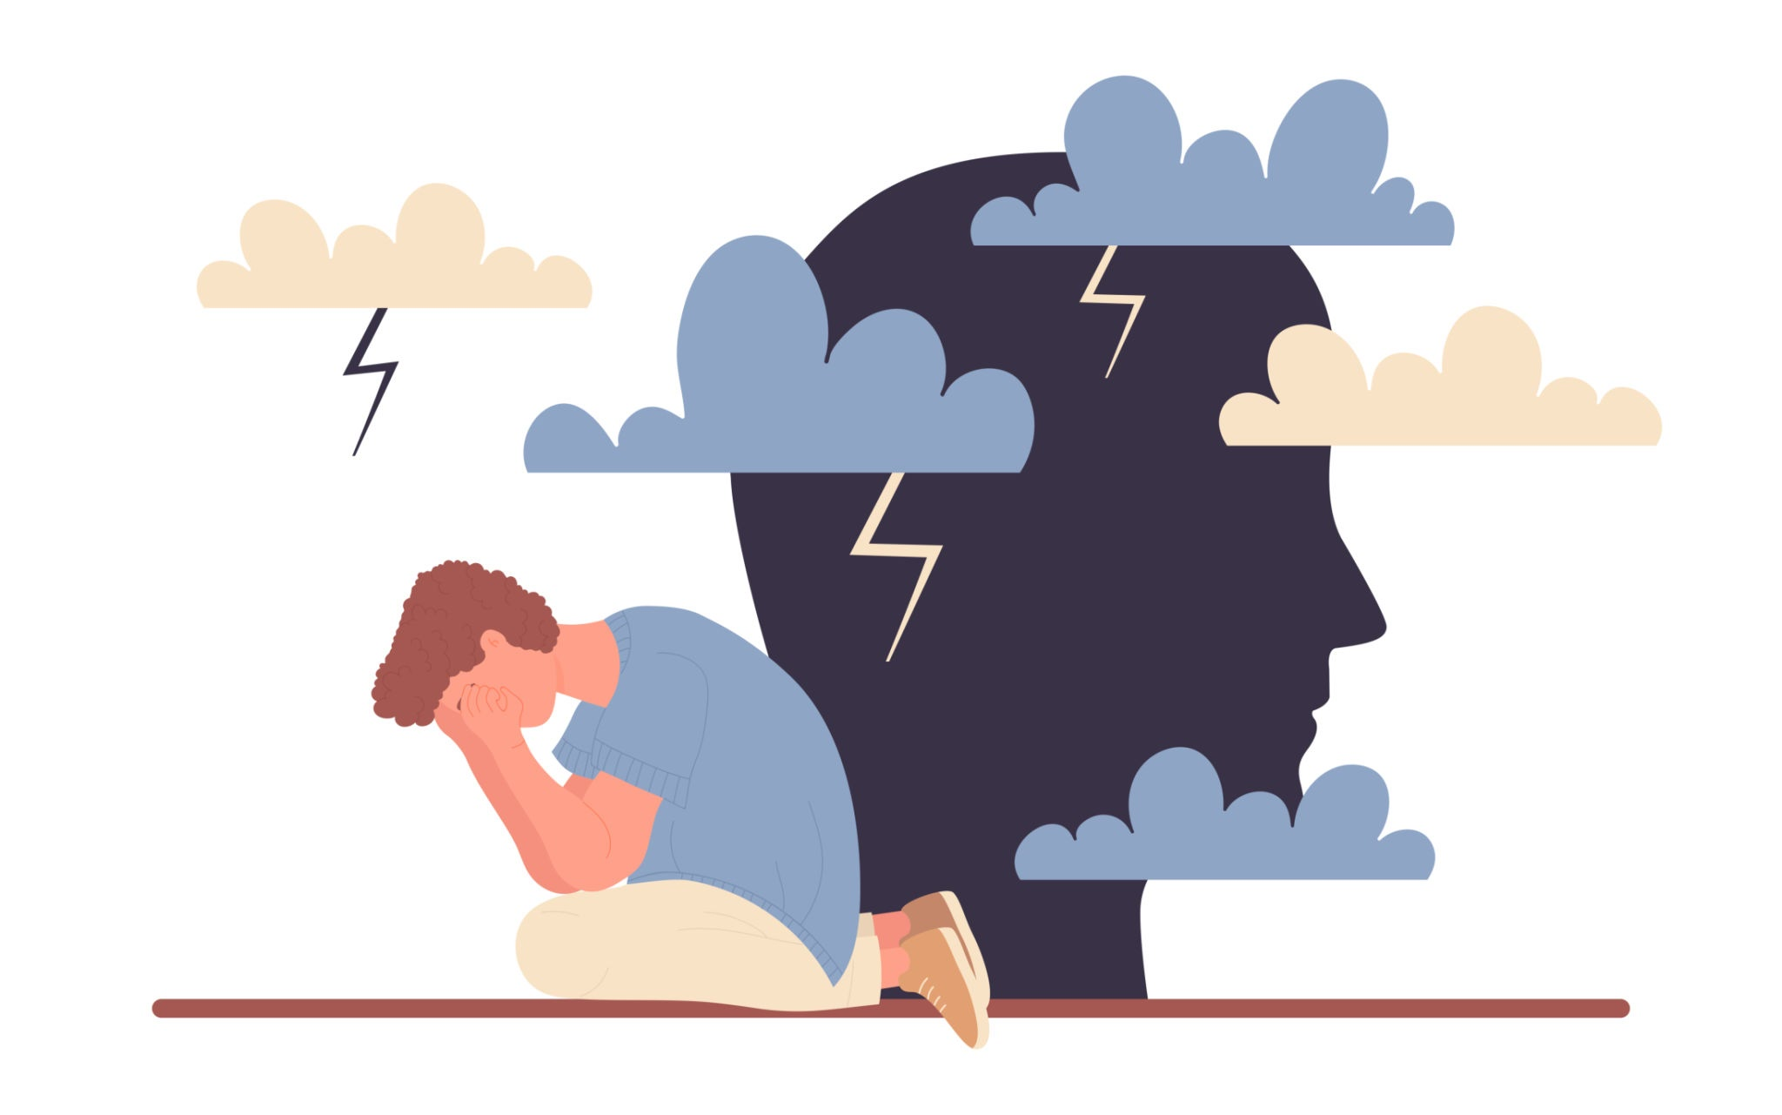
Common Cognitive Reactions
Difficulty concentrating
Difficult memories
Recurring dreams or nightmares
Flashbacks
Difficulty communicating
Difficulty following complicated instructions
Notes:
Review the slide.

Slide 15

Common Faith and Spiritual Reactions
Reliance upon faith
Questioning values and beliefs
Loss of meaning
Directing anger toward God
Cynicism
Notes:
Review the slide.

Slide 16
What helps a person cope?
Having someone listen and be present, having the option to tell our story
Identification, labeling, and expression of our emotions
Regaining some sense of mastery and control over our life
Processing the distressing experience or circumstances in the context of our Catholic faith
Experiencing the love and support of God and our Catholic faith community
Notes:
State that, “Whether a person is experiencing a limited or an acute distress response, or a more chronic situation, we hope to help them move toward some level of relief or some level of recovery.”
Review the slide title for the participants and read bullet points 1, 4 and 5.

Slide 17
Vignette 1-A Stress and Grief
SETTING: Parish community room, after Sunday service. GEORGE (50s) sits alone on a bench, staring at nothing. LAURA approaches with forced brightness.
LAURA: George! There you are. I've been looking for you.
GEORGE: (doesn't look up) Oh. Hi, Laura.
LAURA: (sits down next to him, too close) How are you doing? It's been, what... three months now?
GEORGE: (quiet) Three and a half.
LAURA: Well, you know what they say - time heals all wounds! And I'm sure Sarah wouldn’t want you sitting here looking so sad. She'd want you to move forward, right?
GEORGE: (shifts uncomfortably) I... I guess.
LAURA: You know, when my aunt died, I was devastated too. But then I realized - she's in a better place! She's with Jesus now, George. That's something to celebrate.
GEORGE: (voice flat) Yeah..
Notes:
Say “Now we're going to see what stress looks like in real life. George is struggling with the worst kind of loss. We'll see two scenarios - first, what goes wrong when someone tries to help but doesn't know how. Then, what goes right when someone uses PFA principles.”
Read the slide or have two participants take a role

Slide 18
Vignette 1-A (cont.) Stress and Grief
LAURA: And God has a plan, remember? We might not understand it, but everything happens for a reason. Sarah's death - there's a purpose in it.
GEORGE: (looks away) Right.
LAURA: You just need to pray more. Have you been praying? Prayer changes everything. And you should really come back to Bible study. Keeping busy helps, you know. Idle hands and all that.
GEORGE: (stands up) I should... I should go.
LAURA: Oh! Well, just remember - God never gives us more than we can handle! You’re strong, George. You'll get through this.
GEORGE: (walking away) Thanks, Laura.
LAURA: (calling after him) And smile! Sarah would want to see you smile! (George exits)
Notes:
Read the slide or have two participants take a role

Slide 19
Vignette 1 A – Stress and Grief
  What did you observe?
  How would you feel if someone behaved in this way if you were in distress and needed help?
Notes:
Points to consider:
"It's been three months now" puts a timeline on grief.
“She wouldn't want you to be sad". Added guilt to his grief – he is disappointingg his dead wife.
"She's in a better place" and "God has a plan" - over-spiritualizing. What George hears is your pain doesn't matter because there's a bigger spiritual picture. Just say "I don’t understand why this happened. And I can see how much you're hurting."
Makes it about herself, "when my aunt died." Takes focus away from the person who needs support.
"You just need to pray more" - suggests his pain is evidence of insufficient faith. Prayer doesn't make grief disappear. Prayer gives you strength to carry grief.
"Keeping busy helps“. Grief doesn't go away because you ignore it. It can impact you later.
"God never gives us more than we can handle“. It's not biblical - it's a misquote. And it's factually untrue. People get more than they can handle all the time - people break and have crises. This sound like "you should be able to handle this alone." So they don't ask for help.
"Sarah would want to see you smile" - forced positivity. She's telling him to perform happiness he doesn't feel.
George shut down. He left feeling worse. Misunderstood. So he'll suffer alone.

Slide 20
Vignette 1-B: PFA for Coping with Stress - Grief
SETTING: Same parish community room. GEORGE sits alone. LAURA approaches, but this time she's calm, unhurried.
LAURA: George. May I sit with you for a moment?
GEORGE: Oh. Yeah, sure.
LAURA: (sits, leaving space between them, doesn't rush to fill silence) How are you doing?
GEORGE: Everyone keeps saying it'll get better. That time will heal. But it's not... it's not getting better, Laura. It's getting harder.
LAURA: Harder how?
GEORGE: The shock wore off. Now it's just... real. Every morning I wake up and for one second I forget, and then I remember, and it's like... it's like losing her all over again. Every single day.
LAURA: That sounds unbearable.
GEORGE: (voice breaking) It is. And everyone at church is so... they mean well, but they keep telling me she's in a better place, I have faith, but right now I'm just... I'm angry. I'm so angry.
LAURA: (doesn't flinch) At God?
Notes:
Say “Now let’s see what PFA principals look like for the same situation”
Read the slide or have two participants take a role

Slide 21
Vignette 1-B (cont.) PFA for Coping with Stress and Grief
GEORGE: (looks down) Yeah. At God. We were supposed to grow old together. We had plans. And now...
LAURA: George, your anger and pain makes sense. You lost your wife. That’s devastating.
GEORGE: (crying now) I miss her so much.
LAURA: I know. (pause, just sits with him) I can't take this pain away. I wish I could. But I can sit with you in it. You don't have to carry it alone.
GEORGE: (wiping eyes) Thank you. That's... no one's said that.
LAURA: Is there anything that would help right now? Anything you need?
GEORGE: I don't know. Maybe just knowing that I can talk to someone when it gets really bad?
LAURA: You can call me anytime. There's no timeline. You take all the time you need.
I'm praying for you. Not that you'll "get over it" faster - just that you'll have strength for today.
GEORGE: I appreciate that. (Laura exits)
Notes:
Read the slide or have two participants take a role

Slide 22
Vignette 1 B - PFA for Coping with Stress and Grief
  What did you observe?
  How would you feel if someone behaved in this way if you were in distress and needed help?
Notes:
Points to consider:
Laura asked permission to sit. She sat with space between them. Respected his boundaries. Didn't rush to fill the silence with words.
"How are you doing?" - she waited for a real answer. When he said "I don't know," she didn't push. She gave him permission to not be okay.
George said "it's getting harder." And Laura asked "Harder how?" inviting him to tell his story.
She didn't compare it to her own experience or say "I know how you feel." She just listened.
Laura said, "that sounds unbearable," she didn’t minimize and say "it's not that bad" or "look on the bright side." She acknowledged - this is unbearable.
When George said he's angry at God, Laura didn't correct him. People need to know they can be honest about difficult emotions - including anger at God - without being judged.
Laura said your anger and pain makes sense she told him grief isn't wrong, isn't a lack of faith.
She said "I can't take this pain away. I wish I could. But I can sit with you in it.“ She's honest about her limitations. She's not promising to fix him. She's promising to stay.
She asked "is there anything that would help right now?" - letting him identify his needs. And when he said "just knowing I can talk to someone" - she made a concrete offer. "You can call me anytime." Specific. Actionable.
"There's no timeline, George. You take all the time you need" - directly countering the timeline pressure from Scenario A.
Her closing - "I'm praying for you. Not that you'll 'get over it' faster - just that you’ll have strength for today”, integrates prayer and faith. You're not praying for him to stop grieving. You're praying for him to have strength to grieve.

Slide 23
Reflection & Discussion
1. Think of a time in your life when you experienced something unexpected that was difficult to handle and led to distress.
2. Does your experience relate to the information we learned earlier about reactions to stress/distressing events?
3. Did you receive help from one or more people when you had this experience? Think about what this person, or people, did to help you.
4. What was helpful? What was not helpful?
Notes:
0:25
Ask the participants to break into small groups of 4 – 5 people per group, and to choose someone who will potentially report out to the larger group
Ask the participants to individually think of a time in their life when they experienced something unexpected that was difficult to handle and led to distress.
Now ask them to think about whether they received help from one or more people when they had this experience. Ask them to think about what this person, or persons, did to help them and what it was that was helpful or unhelpful.
Give the small groups 10 minutes for this exercise, to reflect and to share their responses in the small group
Invite a spokesperson from each small group to share some of their reflections on what was helpful and what was not helpful. (Ask them to refrain from going into detail about the difficult experiences that led to them receiving help, and instead to keep focus on the help they received. )
Write down on the flipchart/whiteboard some key words from what participants say. Organize the responses into two columns headed ‘Helpful’ and ‘Not helpful.’
Some examples may be:
HELPFUL • Listened calmly • Called my family • Brought me a glass of water
NOT HELPFUL • Started panicking herself • Interrupted all the time • Talked about themselves
7. Use these responses to emphasize that different things are helpful in different situations and for different people.
0:30

Slide 24
PFA in your Catholic faith community
The Goal of PFA is to offer comfort & hope
The intention is for individuals who will benefit from care to:
  Get needed support, comfort, and prayer from their Catholic community.
  Feel that they have some level of control over their present.
  Have hope that they can experience some relief or achieve some level of recovery.
  Potentially be connected to community resources that may help address their more advanced needs.
Notes:
0:40
Say, “Before we move into the PFA Action steps ‘Look, Listen, and Link’, let’s review what we have learned.”
Then review the slide.

Slide 25
Look, Listen, and Link
the order of these actions may be different and may take place in different ways and sequences depending on the situation
at times, some actions may take place simultaneously
Notes:
Explain, “Now we will learn more about the three action steps, ‘Look, Listen and Link.’
They are easy to remember and are useful prompts in providing PFA to someone in distress. “
(Review the slide.)
Add, “Some people may need more help than can be provided by psychological first aid.
Part of learning psychological first aid skills is learning how to recognize when someone needs other types of help and knowing who to contact if the person in distress needs more help than we are qualified to give. “

Slide 26
Promote Safety: other’s and your own
Do not engage if it will put yourself or others’ safety at risk
Contact medical, mental health, or safety professionals if necessary
If you are in doubt, consult
Notes:
0:45
Stress that “It is of utmost importance, it is critical to ensure that everyone’s physical, emotional, psychological, and spiritual safety are held paramount whenever offering PFA.”
Then review the three bullets on the left of the slide.

Slide 27
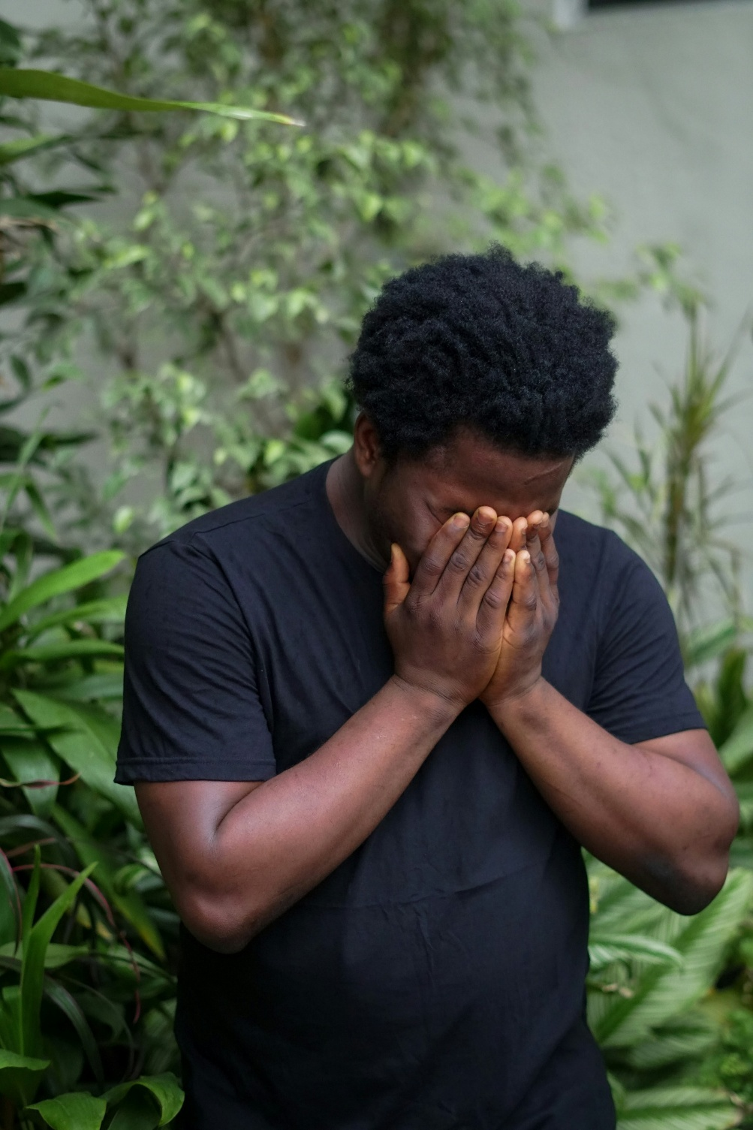
Look for:
Someone who appears to be, or shares that they are, in distress
Someone who seems they may be struggling with a mental health challenge, or struggling as they care for someone with a mental health challenge
Someone having a reaction to a disaster or traumatic event in your community
Notes:
Explain that the first step in the PFA Action Steps is to Look
Review the slide bullet points
Add that a critical action within the “Look” step is to assess if anyone needs to be connected with immediate safety professionals or professional mental health support – determine, is anyone in crisis?
Add that, “In the case of a disaster or traumatic event in your community, look for:
information on what has happened and is happening
who may need help
any safety and security risks
any physical injuries
any immediate basic and practical needs
emotional reactions people may be experiencing”

Slide 28

After Looking, if you decide to approach
Think about:
1. Why it is important to be aware of how you approach someone?
2. How is it best to introduce yourself to someone in distress?
3. What information is important to share about you as a PFA/mental health ministry helper?
4. How would you prefer someone approach you if you were in distress?
Notes:
Ask participants to think about the questions on the slide.
Ask if they would approach different people in their culture and context differently. For example, would they greet men or women, older people or young adults, in different ways?
If time allows, invite members of large group to reply to the questions.
Add that, ”Psychological first aid can be provided in any setting where it is safe and comfortable for the helper and person(s) in distress. It is best to provide psychological first aid in a quiet and calm environment where everyone feels safe and secure. Privacy is essential for confidentiality. “

Slide 29
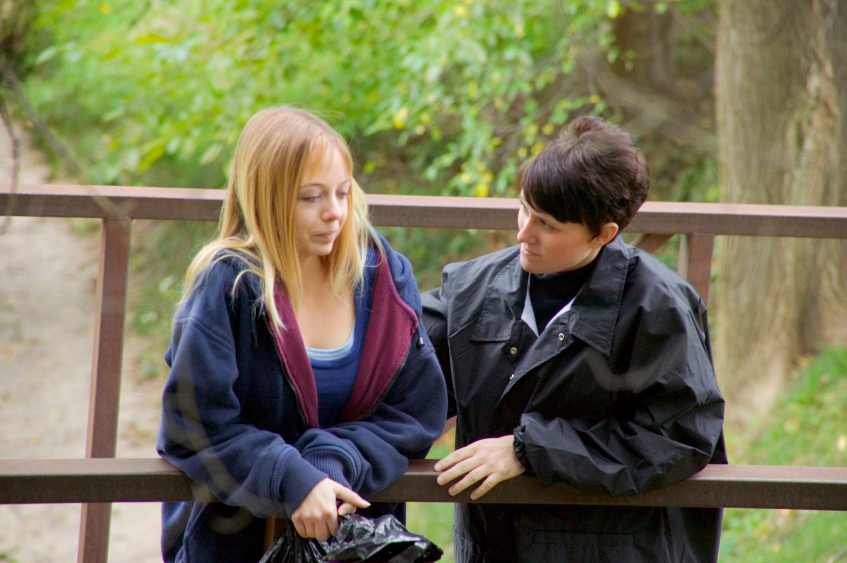
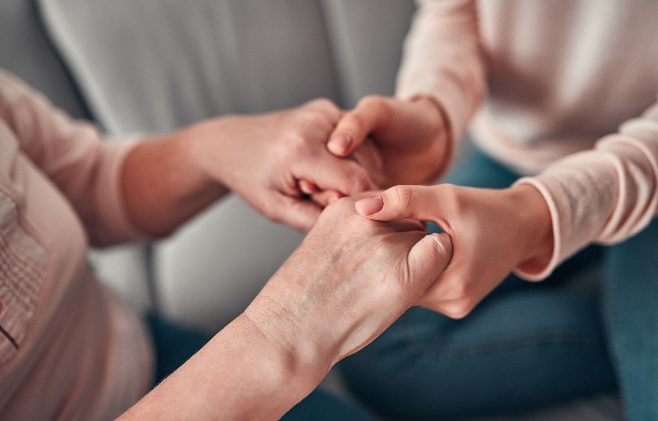


Listen: seek out and engage
INTRODUCE YOURSELF
BE A COMPASSIONATE PRESENCE
ASK SIMPLE QUESTIONS TO CLARIFY YOUR UNDERSTANDING
LISTEN, LISTEN, LISTEN
Notes:
0:50
Explain that the second action principle, LISTEN refers to the way you communicate with someone from the very first moment you approach and interact with the person in distress.
Share that “LISTEN refers to how the PFA provider:
approaches someone
introduces oneself
pays attention and listens actively
accepts others’ feelings
calms the person in distress
asks about needs and concerns”
3. Emphasize that someone offering PFA should follow the lead of the individual in discussing what happened or what their struggle is.
Avoid asking for in-depth descriptions of traumatic experiences.
Individuals should not be pressed to disclose details of any trauma or loss.
Pressing or forcing someone to share these details could be harmful to their well-being

Slide 30

Helpful communication skills
Talk privately, if possible, at a mutually convenient time in a place free of distractions.
A person may not open up to you initially, or until they are sure that you care.
Ask questions that are open-ended, inviting the person to share more.
Use a nonjudgmental tone.
If you don’t know an answer, say “I’m not sure what to do, but I may be able to help you find someone who does.”
Notes:
Share that “When we offer the gift of listening to someone who is in distress, we can practice communication skills that are more helpful.”
Explain that knowing more helpful responses when we seek to offer PFA is key and that a good way to get a sense of what may be a helpful response, is to recall those experiences in our own lives when someone has offered helpful replies in response to our own challenging situation.
Say, in addition to the points on the slide, here are some other points to keep in mind:
1) A person may downplay what they are going through to avoid upsetting you or may not recognize there is a problem.
2) Let the person know you are ready when they are - do not put pressure on them to talk if they do not wish to do so.
3) Ask questions that are open-ended, inviting the person to share more. Only to increase your understanding, not to be nosy.
4) Use “I” statements, these can feel less threatening. (“I’ve noticed you been very quiet in Faith Sharing lately.”)
5) Share that you are concerned.
State, “Remember, those you seek to help are the experts of their own needs.”

Slide 31
Vignette 2-A: Depression
SETTING: Church library. MICHELLE (30s) sits at a table, staring blankly at her phone. LINDA enters, sees her, approaches with bright energy.
LINDA: Michelle! Hey! I haven't seen you at Bible study in weeks. We've missed you!
MICHELLE: (barely looks up) Oh. Yeah. I've just been... tired.
LINDA: (sits down across from her) Tired? Come on, we're all tired! That's life, right? (laughs) But you can't let that stop you. You've got to push through!
MICHELLE: (quiet) I guess.
LINDA: Are you not sleeping well? You should try melatonin. Or maybe you're sleeping too much? My cousin had that problem and she just set an alarm and forced herself to get up early.
MICHELLE: It's not really about sleep.
LINDA: Well, what is it then? You need to get out, get some exercise, get those endorphins going. Depression is all about brain chemistry, right? So, you've got to do things that boost your mood.
MICHELLE: (looking down) I don't think I have depression.
Notes:
Say “ Now we meet Michelle. She is fighting depression. A quiet struggle, often invisible, often misunderstood. Michelle's story teaches us a great deal about listening - about what it looks like when we get it wrong, and what changes when we truly get it right.”
Read the slide or have two participants take a role

Slide 32
Vignette 2-A (cont.): Depression
LINDA: Oh honey, we all get a little depressed sometimes. But you've got to make a choice to be happy. I know it sounds harsh, but it's true - happiness is a choice.
MICHELLE: (voice barely audible) Okay.
LINDA: And you need to think about your husband, your kids - they need you to be present. They need you to show up. You can't just check out because you're feeling down.
MICHELLE: (eyes filling with tears) I'm not trying to check out.
LINDA: Pray about it. Ask God for strength. Maybe come back to Bible study - being around positive people will help.
MICHELLE: (stands up) I should go. I have to... I need to pick up my kids.
LINDA: Okay, but think about what I said. You've got everything to be grateful for - a husband who loves you, beautiful kids, a good life. Sometimes we just need to count our blessings and realize how good we have it.
MICHELLE: Right. Thanks, Linda. (Michelle exits quickly)
Notes:
Read the slide or have two participants take a role

Slide 33
Vignette 2A - Depression
  What did you observe?
  How would you feel if someone behaved in this way if you were in distress and needed help?
Notes:
Points to consider:
Saying "we all feel that way," is telling the person their experience isn't special, isn't worth attention. What might be a pebble for you can be a boulder for someone else.
Offering solutions - melatonin, set an alarm, get outside, exercise. All might be helpful for someone feeling a bit low. None of them address clinical depression.
"Depression is all about brain chemistry” - technically she's right that depression involves brain chemistry. But she's treating it like Michelle can just exercise it away. Would you tell someone with a broken leg to just push through the pain and walk? No. But we do this with mental illness all the time.
"Happiness is a choice" - this is very damaging thing. Michelle is now thinking "if I'm not happy, then I'm choosing to be miserable and choosing to hurt my family. This is my fault.“ You've just taken someone who's already struggling and added shame and guilt
"Snap out of this" - if Michelle could snap out of it, she would. This isn't something you snap out of.
"You've got everything to be grateful for" - telling someone with depression to just be grateful is like telling someone who's drowning "but there's so much air around you!" It doesn't help.
Michelle now thinks the church can't help her. If Linda, a mental health minister, responded this way, Michelle assumes everyone at church will respond this way. She won't come back. She'll suffer alone.

Slide 34
Vignette 2-B: PFA for Active Listening and Depression
SETTING: Same church library. MICHELLE sits at the table, staring at her phone. LINDA enters, sees her, approaches gently.
LINDA: Michelle? Hi. Is it okay if I join you for a minute? (sits, leaving space) How are you doing?
MICHELLE: I don't know. Not great. Everything feels heavy. I'm sorry, I don't want to burden you.
LINDA: You're not burdening me. How long has this been going on?
MICHELLE: Maybe six months? I can't get out of bed in the morning. I mean, I do - I have to, for my kids - but it takes everything I have. Nothing feels good.
LINDA: That sounds exhausting.
MICHELLE: (tears forming) It is. And I feel so guilty because I have a good life. I have a husband who loves me, kids who need me. I know I'm not crazy. But I think I'm depressed.
LINDA: Depression isn't being crazy. It's a medical condition that affects how your brain functions.
MICHELLE: I thought if I just prayed more, or had more faith...
Notes:
Say “Let's see what using PFA principles looks like with depression.”
Read the slide or have two participants take a role

Slide 35
Vignette 2-B (cont): PFA for Active Listening and Depression
LINDA: Prayer is important. But depression is a health problem. You wouldn't tell someone with diabetes they just need to pray harder for their pancreas to work, right? Would you be open to talking to someone? A doctor, or a therapist?
MICHELLE: (hesitates) I'm scared. That they'll think I'm a bad mom.
LINDA: (firm but gentle) Michelle, seeking help for depression doesn't make you a bad mom. It makes you a good mom. Because you're taking care of yourself so you can take care of them.
MICHELLE: Okay. I think... I think I need to do something.
LINDA: That's really brave. And Michelle? If you need to talk, if you need someone to sit with you, if you just need someone to know what you're going through - I'm here.
MICHELLE: Thank you. Really. Thank you.
LINDA: You don't have to thank me. This is what we're supposed to do for each other. Can I check in with you in a few days?
MICHELLE: Yeah. I'd like that.
Notes:
Read the slide or have two participants take a role

Slide 36
Vignette 2B - PFA for Active listening and Depression
  What did you observe?
  How would you feel if someone behaved in this way if you were in distress and needed help?
Notes:
Points to consider:
She asked permission to join and approached gently. When someone is depressed, enthusiasm can feel aggressive.
"How are you doing?" and waited for a real answer. She asked clarifying questions. She's helping Michelle articulate her experience.
Validation - when Michelle described numbness, Linda said it - "that sounds exhausting.“ Not "oh everyone feels that way." Not "just push through."
When Michelle said "I think I’m depressed“. Linda didn't minimize it, didn't talk her out of it. She made it clear this is a health condition, not a character flaw.
She addressed the faith component. She said "faith is important, but depression isn't a faith problem. It’s a health problem.”
She suggested professional help. When Michelle expressed fear, Linda didn't dismiss it. She addressed it directly. "Seeking help doesn't make you a bad mom. It makes you a good mom."
Linda made it clear "while you're getting help, I'm here." She's not abandoning her. She's saying "I'll walk alongside you."
Michelle left still depressed. Linda didn't cure her. But Michelle now has hope. She has a path forward. She has someone in her corner.
That's what PFA does. It recognizes it, validates it, and connects the person to appropriate help.

Slide 37
ACTIVE LISTENING is an attitude and a set of skills that can help someone in distress. It is more than sitting passively while someone speaks to you. Active listening is both verbal and nonverbal.
NON-VERBAL
VERBAL
• Using body language, such as eye contact, facial expressions, gestures
• Being aware of space, such as how you distance, position, and orient yourself in relation to the other person
• Taking the time needed to understand what the other person is going through
• Appropriate silence
• Avoiding interruptions
• Asking questions to improve your understanding of what is being shared
• Restating and summarizing what the person has said in your own words to ensure understanding
• Being encouraging and positive
• Accepting others’ feelings and trying to avoid letting your own moral values or beliefs influence your helping behavior
Notes:
0:55
Share that, “Listening is not something we do only with our ears. That is hearing. Listening involves all the senses and is also about our behavior. Listening is being present, paying attention and trying to understand what has happened to the person in distress, what they are feeling, and what they need. It is being open, curious, and sensitive to what the distressed person is experiencing. It is also recognizing when someone does not want to talk and allowing silence.
Say, “What Linda did with Michelle in that second scenario — the way she leaned in, asked follow-up questions, named what she was hearing, made space for silence — that has a name. That was active listening.”
State that, “We will continue to explore a psychological first aid skill today called ‘active listening’. This is a powerful skill, as being a good listener is something that benefits us in all aspects of our lives, not only as a psychological first aid helper. It is a life skill that can improve our relationships with others at home, in our church community, and at work. “
Review the slide.
Add that, “For verbal encouragement, we might say things such as: You are not alone. • I am here for you. • You don’t always have to feel the way you feel right now. • I’m here if you want to talk. • I want to help you through this. “
Also share that, “We can explain some support options to the person by using the phrase, “For some, for others, for you.” An example of a way to build on this phrase is: • “For some individuals who experience loss, they talk to their family and friends. For others, they consider talking to a counselor. For you, it’s important to find what works best and I am here to support you.”
(If time allows, after reviewing the slide, ask the participants to give examples where their own moral values or beliefs might influence the way they interact with someone else – in more helpful or in less helpful ways.)

Slide 38
Communication - What may be unhelpful things to say?
1. When you've been in a challenging situation, what are some unhelpful comments that have been made to you?
2. What are some unhelpful comments you’ve heard made to others?
Notes:
Say, “Knowing helpful responses when we seek to offer PFA is key. Avoiding offering less helpful responses is another skill.
A good way to get a sense of what may not be a helpful response, is to recall those experiences in your own life when someone has offered unhelpful replies in response to your own challenging situation.”
Share your own example(s) and take a few examples form the audience (ex. “Bloom Where You are Planted.”, sounds nice – may even be embroidered on a throw pillow, but actually means – quit complaining, suck it up, and deal with it.)

Slide 39

Communication: phrases to avoid
Let’s talk about something else
You should just pray more
It is God’s will
I know exactly how you feel
You’ll feel better soon
You need to relax
Notes:
Share that, “Saying some of these phrases listed on the slide can make someone feel their distress is being dismissed. Also, some of these statements may not be true.
These statements may shut down someone’s willingness to talk with us and so may hamper our opportunity to be a helpful presence.
As Catholics, we are people of hope and we are called to share hope – especially in the midst of challenging situations. At the same time that we express hope we must also acknowledge the reality of a person’s distress and not minimize or dismiss their experience through over-spiritualization.
Some examples of over-spiritualization are to say to someone who is in distress, “You just need to have more faith”, or “You just need to go to Mass and to the Sacrament of Reconciliation more often.”
Engaging in practices that increase our faith will benefit us, but these practices almost certainly will not cure a chronic mental illness or restore someone’s home if it has been damaged by a hurricane or flood. “

Slide 40
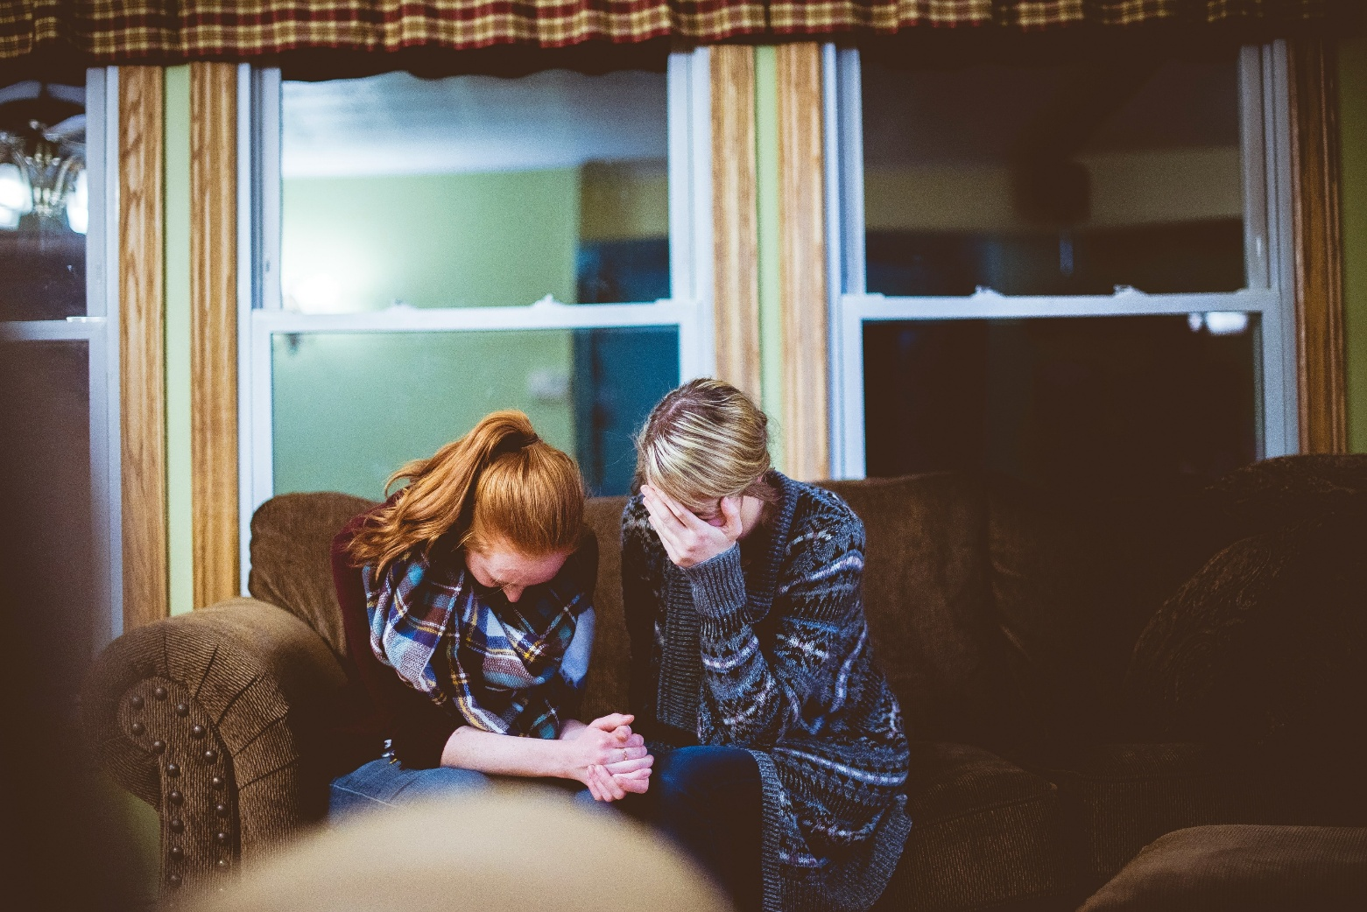
Calm and comfort
Meet the person where they are
Don’t push for information
Don’t make yourself the focus
Most often, people just need someone to talk to about their experience:
  Someone to care
  Someone to really listen
  Someone to pray or cry with
  Someone to BE PRESENT with them
Notes:
1:15
State that our goal in PFA is to offer calm and comfort.
Review the slide bullet points.
Emphasize that, “It is vital in MHM and in PFA that we do not overpromise, instead we need to be honest about what we and our MHMs are and are not able - or willing - to do for the person. Setting and adhering to reasonable and clear boundaries is key.”

Slide 41
Vignette 3-A: Addiction
SETTING: Church parking lot after evening Mass. CARLOS leans against his car, exhausted. THOMAS approaches.
THOMAS: Carlos! Hey man, haven't seen you at men's group lately. Everything okay?
CARLOS: (looks around, lowers voice) It's my brother. Miguel. He’s using again.
THOMAS: Look, I'm going to be straight with you because somebody needs to say it - you’re enabling him. Every time you bail him out, every time you let him stay at your place - you're making it easier for him to keep using.
CARLOS: He's my brother. What am I supposed to do, let him die on the streets?
THOMAS: Sometimes people need to hit rock bottom before they get serious about recovery.
CARLOS: (angry) You don't understand. He has nowhere else to go.
THOMAS: That's his problem, not yours. You've got your own family to think about. How is this affecting them?
CARLOS: My wife is... she's at her limit. She doesn't want him in the house anymore.
Notes:
Read the slide or have two participants take a role

Slide 42
Vignette 3-A (cont.) Addiction
THOMAS: Of course she doesn't! Tell Miguel he can't come back until he’s sober. Tough love - that's what he needs.
CARLOS: I've tried that. He just disappears and I don't know if he's alive or dead.
THOMAS: That's his choice, Carlos. You can't save someone who doesn't want to be saved. Miguel is using you and so that he can go get high again.
CARLOS: (voice tight) He's not using me. He's sick.
THOMAS: He's sick because he keeps choosing drugs over his family. That's on him, not you. Tell him you're done until he gets serious about rehab.
CARLOS: (defeated) I don't think I can do that.
THOMAS: Then you're part of the problem. Look, I know that sounds harsh. You can't set yourself on fire to keep someone else warm.
CARLOS: (nods numbly) Yeah. Okay. I should go.
THOMAS: Think about what I said. And pray about it. God will show you what to do.
CARLOS: (gets in car) Right. Thanks. (Carlos drives away)
Notes:
Read the slide or have two participants take a role

Slide 43
Vignette 3A - Addiction
  What did you observe?
  How would you feel if someone behaved in this way if you were in distress and needed help?
Notes:
Points to discuss:
Carlos asks, "How many times is this now?” Counting relapses like failures just adds shame. Addiction is a chronic relapsing condition. Relapse is often part of recovery.
“You're enabling him" - "You're part of the problem" - "You're making it easier for him to keep using.” these phrases get thrown around constantly. And sometimes their true. But Thomas uses them as accusations, not to start a conversation. He's turning Carlos - who is exhausted from trying to keep his brother alive - into the villain.
"Are you helping him, or are you just making yourself feel better?" Thomas is suggesting Carlos's motivation is selfish.
"Tough love - that's what he needs" - "Sometimes people need to hit rock bottom" - Thomas is prescribing a specific approach without knowing Miguel and without understanding the full situation. Thomas is not a counselor. Many people die before they hit their supposed rock bottom. That's asking Carlos to live with potential death on his conscience.
When Carlos said "He just disappears and I don't know if he's alive or dead," Thomas dismissed it as if Carlos’s fear is irrelevant.
"You've got your own family to think about" – this is a false choice. You can love both, even when it's complicated.
When Carlos said "He keeps choosing drugs over his family“ and "That's his choice." - this frames addiction as purely a choice issue. It ignores the neuroscience. Miguel's brain is hijacked. It's not a simple choice.
“He's using you" - dehumanizing Miguel. Reducing him to his addiction. Ignoring that he's a person who is sick.
"Carlos is left more alone, more ashamed, more confused than when the conversation started. This what the wrong approach does with addiction - it oversimplifies, judges, and isolates.

Slide 44
Vignette 3-B: PFA Communication and Addiction
SETTING: Same church parking lot. CARLOS leans against his car, exhausted. THOMAS approaches.
THOMAS: Carlos. Hey. You look exhausted, man. You okay?
CARLOS: Not really. It's my brother. Miguel. He's using again.
THOMAS: Want to talk about it? How are you holding up? Can you tell me what's going on?
CARLOS: He showed up at my house three weeks ago. High, broke, nowhere to go. I couldn't just turn him away. My wife won't let him in the main house with the kids. And I get it, I do. But he's my brother. And I see him out there, shaking, sweating, and I just...
THOMAS: You feel like you're failing him either way.
CARLOS: Yes. If I let him stay, I'm enabling him - that's what everyone says. But if I kick him out, what if I find out he overdosed in some alley and died and the last thing I did was turn him away?
THOMAS: That's an impossible position to be in.
CARLOS: (wipes eyes) I just want him to be okay. I want my brother back.
Notes:
Read the slide or have two participants take a role

Slide 45
Vignette 3-B (cont): PFA Communication and Addiction
THOMAS: I know. And that's not weakness, that's love. But here's what I want you to hear - Miguel's addiction is not your fault. And it's not your responsibility to fix it.
CARLOS: Then what am I supposed to do?
THOMAS: Have you talked to anyone? A counselor? A support group for families dealing with addiction? Like Al-Anon, Nar-Anon - People who understand what you're going through. Would you be open to that?
CARLOS: (hesitates) Maybe. I don't know. I just feel so alone in this.
THOMAS: You're not alone. If you need to talk, if you need someone who won’t judge you, if you just need to sit in your car and cry - call me. Anytime.
CARLOS: Thank you. I mean it.
THOMAS: Do you want me to help you find a support group? I can look some up, send you information?
CARLOS: Yeah. Yeah, I think I need that.
THOMAS: Okay. I'll get you some resources. You're doing the best you can in an impossible situation. That's all anyone can do. (They shake hands. Carlos gets in his car)
Notes:
Read the slide or have two participants take a role

Slide 46
Vignette 3B - PFA Communication and Addiction
  What did you observe?
  How would you feel if someone behaved in this way if you were in distress and needed help?
Notes:
Points to discuss:
"You look exhausted" - he named what he observed without judgment. When Carlos said "not really," Thomas didn't push. He just offered "want to talk about it?“
When Carlos said Miguel is using again, Thomas's first response was "I'm so sorry. How are you holding up?" Not "how many times is this." Not "you're enabling him." Just compassion.
Carlos shared the impossible situation - wife says no, brother has nowhere to go. And Thomas said "you feel like you're failing him either way.“ That's validation - acknowledging the reality. Not offering easy solutions.
When Carlos shared his terror about Miguel dying, Thomas didn't dismiss it. He said "what you're carrying right now - that's an unbearable weight."
"Miguel's addiction is not your fault. And it's not your responsibility to fix it.“ He's separating Carlos's worth from Miguel's recovery.
"You can love your brother without destroying yourself" - both can be true. It's not either/or.
Thomas didn't prescribe what Carlos should do. He asked "have you talked to anyone?" He offered resources - support groups specifically for families dealing with addiction.
He validated that "whatever you decide doesn't determine your worth as a brother.“ Carlos needed permission to take care of himself without guilt. Thomas gave him that permission.
Thomas didn't fix the situation. Miguel is still addicted. Carlos still has impossible choices. But Carlos now has support, resources, and less shame.
That's what PFA does - it holds the complexity, validates the caregiver’s burden, and connects to appropriate support.

Slide 47

What about prayer?
SUBTLE
Pray for the person silently
Add their intention (maintain confidentiality) to your parish prayer list or the CMHM Prayer Ministry
OVERT
Pray together with the person:
  a Rosary, Stations of the Cross, or other rote prayers
  a spontaneous prayer
These prayers could be silent or spoken out loud
Notes:
Review the slide.
Add that, “If someone is in need of advanced spiritual care, it is our role to Link that person with a deacon, pastor, or other person with more spiritual training and authority than we posses.
We can do our best to link the person with a person who has some knowledge and understanding about the person’s issue.”
Share that, “Prayer and sacraments support healing — but they are not replacements for therapy or medicine. A common theological phrase is that “Grace builds on nature.” Priests minister grace alongside the natural means of healing God provides.”

Slide 48

LINK: connect people to other resources
If someone does not want help, do not try to impose it.
  Only give accurate information about what you and/or your community may be able to offer, do not offer platitudes or false hope.
Each region or community can curate a list of local resources that may be of help.
Notes:
State that, “The third action and final action step is LINK.“
Say that, “It is often simple gestures of caring that people need when they are in distress, so that they can feel calm, and potentially to gather their energy to make decisions on what to do next. In the listen step you may have already begun to identify what the person may need, you may have begun to assess what you may be able to do in the immediate situation, and also what you might do to link them to more help from elsewhere. “
Review the slide.
Say, “We will discuss potential exceptions to this in cases where a person(s) may be in immediate critical danger
Add that, “It may be appropriate to connect people with social support and help them access services and other help. a list of local resources that may be of help:
Medical, Safety, and Mental Health Crisis Hotlines
Organizations for Obtaining Housing and Other Basic Necessities
Advanced Mental Health Care
Advanced Spiritual Care (Clergy or Spiritual Directors)
6. Note that participants should remember that providing psychological first aid may be a one-time intervention, and they may only be there to help for a short time. Even with this limitation, they can still be of great help, particularly if the person needs to be linked to other help and participants are able to help make that happen.

Slide 49
When additional support is needed
It is cause for immediate concern if someone shows or shares:
• Unresponsiveness to verbal questions or commands
• They have no food, water or a place to sleep
• A loss of control over their behavior and behave in an unpredictable or destructive manner
• A threat to harm themselves or others, expresses suicidal ideation
• Significant withdrawal - change in behavior
Notes:
1:20
State that, “There are some situations that may be a crisis, where it is important to refer a person for professional mental health or other health-related support as soon as possible. – these situations may require calling a crisis line like 911 or 988 (USA lines).
Review the bullet points and the slide and add share these points too:
• They have been harmed or abused and thus may need protection and medical care
• They are so distressed that they are unable to function normally and care for themselves by, for example, not eating or keeping clean despite food and washrooms available
• A new habit of excessive use of drugs or alcohol
• They have not been able to sleep for the last week, or they are confused and disorientated – unable to focus

Slide 50
Concerned someone may wish to harm themselves
Ask the question directly, doing so will not ‘put the idea of suicide’ into someone’s head.
Ask:
        1. Are you thinking about suicide?
        2. Are you thinking about killing yourself?
This gives the person the opportunity to share if they are feeling this way. This can bring them relief.
Having this conversation in a clear and direct manner can allow you to connect them to potentially life-saving help.
Notes:
Review the slide title and first bullet point and tell the participants it is time for an exercise to help them gain comfort in addressing the issue of suicide with someone.
Have the learners practice asking these questions together as a group and then in pairs.
Ask them to reflect on this experience and ask a few volunteers to share in the large group how this exercise made them feel.
Add, “If someone answers “yes” to these questions, ask if the person has a plan. If they have a plan, this is potentially am even more severe crisis and medical and/or MH professionals will need to know this information. If someone answers yes to any of these questions, you will need to access advanced care resources.”
State that words matter in how we talk about suicide (avoid “committed suicide”; say “died by suicide”).

Slide 51

What if additional support is needed?
When in doubt – CONSULT!
- If someone’s life is in immediate danger, this is a crisis - contact medical, safety, or mental health professionals.
- Do not leave a person who is at risk unattended until help has arrived or you have reached a place where you can get more help.
- Know who you can turn to for assistance: supervisor, mental health professional, crisis help line.
Notes:
1:25
Review the points on the slide.
Add, “Your parish, diocese or MHM team may have information about your local referral system. If you need to link a distressed person to a service or support system that you do not have the contact details for, you can contact these resources for help and support. “
Stress that PFAiders should know how to get assistance – this will depend on the situation and their parish or diocesan policies and resources. PFAiders should learn what these are in their communities.
Add, “If you provide PFA in another capacity, for example in your own private relationships, it is still important to refer elsewhere for more advanced help as needed, and to avoid trying to provide support that is beyond your expertise. “

Slide 52
Someone may remain/become agitated
Refuse to follow directions
Experience loss of control, becoming verbally agitated
Become threatening
It is usually not personal
This may be their reaction to a distressing situation, and it likely has nothing to do with you.
Notes:
Review the slide.

Slide 53
If someone is agitated
If it is safe to do so, attempt to de-escalate.
Be kind, calm and compassionate and:
  Be sure everyone involved is safe and has a clear exit from the area.
  If anyone’s safety is at risk, call an appropriate mental health or safety professional.
  Express patience and compassion in your words and manner, reflect the love of Jesus.
  If the situation cannot be resolved, if de-escalation is not possible, call an appropriate professional.
Notes:
Review the slide.
Add that, “People in great distress often feel confused or overwhelmed, and may have physical reactions like shaking or trembling, difficulty breathing or increased heart rate. A key skill in PFA is to know how to help someone feel calm if they are having a reaction like this. “
Share,
“If it could be helpful, encourage the person to focus on their breathing and to breathe slowly
Remain courteous and respectful, do not argue or threaten.
Remind the person you are there to help them and, if it is true, that they are safe.
Speak in a calm and soft tone of voice, using simple language and short sentences.”

Slide 54
Vignette 4-A: Psychosis
SETTING: Parish hall kitchen. LUCY (40s) is washing dishes alone after a parish event. She’s visibly tense, jumping at sounds. CAROL enters.
CAROL: Lucy! There you are, hiding in the kitchen again.
LUCY: (lowers voice, moves closer) Carol, can I tell you something? Something's going on. I think... I think people are watching me.
CAROL: (laughs lightly) Watching you? What do you mean?
LUCY: I know it sounds crazy. But there are these cars that keep parking outside my house. The same cars, different days. And my neighbor - he's been talking to people. I've seen him. And at work, people stop talking when I walk in the room.
CAROL: Lucy, honey - I think you're just stressed. Everyone's stressed right now.
LUCY: No, it's not stress. This is real. Something is happening. I've been keeping notes, writing down license plates, times...
CAROL: (gently but dismissively) Oh, Lucy. I think you might be overthinking this. You’ve always been a little anxious, right? Maybe you need a vacation.
Notes:
Read the slide or have two participants take a role

Slide 55
Vignette 4-A (cont.): Psychosis
LUCY: (frustrated) I'm not anxious. I'm telling you what I've seen. Why won't anyone believe me?
CAROL: I believe that you believe it. But think about it rationally - why would anyone watch you? There's no reason for that.
LUCY: (defensive) I don't know why. But I know what I see.
CAROL: Look, I'm not trying to dismiss you. But I really think this is anxiety. Maybe talk to your doctor about medication? Something to take the edge off?
LUCY: (pulling back) I'm not crazy. I don't need medication.
CAROL: I didn't say you were crazy. I just think you're under a lot of stress and your mind is playing tricks on you.
LUCY: (turns back to dishes) I'm fine. Really. Forget I said anything.
CAROL: (after a pause) Lucy, don't be like that. I'm trying to help. I'm sure it will all seem less scary after a good night's sleep. (Carol exits. Lucy stares at the dishes, more alone and more frightened than before.)
Notes:
Read the slide or have two participants take a role

Slide 56
Vignette 4A - Psychosis
  What did you observe?
  How would you feel if someone behaved in this way if you were in distress and needed help?
Notes:
Points to discuss:
The paranoia and disordered thinking are potential symptoms of a serious mental health condition.
Carol dismisses Lucy’s experience. The light laugh immediately signaled "this isn't serious. "I think you're just stressed“. Carol's first move is to normalize and dismiss it.
"You've always been a little anxious" -"Overthinking." - "Vacation." – Carol is deciding what this is before she's even listened. Lucy is describing something much more frightening than anxiety.
Carol tries to make a logical argument - "think about it rationally, why would anyone watch you?" But Lucy’s brain that's generating these thoughts is the same brain you’re asking to rationally evaluate them. She can’t. The experience is real to her.
Carol says "I'm not trying to dismiss you. But I really think this is anxiety.“ She literally dismisses her in the same breath as saying she's not dismissing her.
“Talk to your doctor about medication" - the intent is right, but the framing is wrong. It comes across as "take a pill so you stop seeing things that aren't there." Lucy hears "you're crazy and you need to be medicated."
"I didn't say you were crazy" - but by this point, that's exactly what Lucy heard. And so she said “Forget I said anything.“ Carol lost her. And Lucy is now more isolated with her terror. She tried to reach out and was dismissed.
Carol can't diagnose Lucy. Whatever is causing these experiences - whether it's a mental health condition, extreme stress, or something else entirely - she needs professional evaluation. And Carol’s dismissal made that less likely to happen.
Carol should not agree that people are watching Lucy but she should take her distress seriously and help her get the right support.

Slide 57
Vignette 4-B: PFA and Psychosis
SETTING: Same parish hall kitchen. LUCY washes dishes alone, tense. CAROL enters.
CAROL: Lucy? Hey. You okay? You seemed really on edge tonight.
LUCY: (startled) Sorry. I'm just... I'm not great.
CAROL: Do you want to talk about it?
LUCY: (long pause) Can I tell you something? And you won't think I'm crazy?
CAROL: (sits on a kitchen stool, full attention) Of course. What's going on?
LUCY: I think someone is watching me. There are cars outside my house. The same cars. Different days. And people at work stop talking when I walk in. And my neighbor - he's been talking to people, making calls. I've been keeping notes.
CAROL: That sounds really frightening.
LUCY: It is. I'm scared all the time. I can't sleep. I keep checking the windows. I lock the doors and then check them again. It's exhausting.
CAROL: How long have you been feeling this way?
LUCY: A few months. It started small and then it just... grew. Now it's all I can think about.
Notes:
Read the slide or have two participants take a role

Slide 58
Vignette 4-B (cont.): PFA and Psychosis
CAROL: Lucy, I wasn't there; I didn't see what you saw. But what I can see right now is that you're exhausted and scared and you’ve been carrying this alone for months. And you deserve help with that, from someone qualified.
LUCY: A psychiatrist? (pulls back slightly)
CAROL: Or your regular doctor, to start. Just a conversation with your doctor about what you've been experiencing. Would that feel manageable?
LUCY: What if they don't believe me either?
CAROL: Then you find a doctor who does. You deserve to be taken seriously. Would it help if I came with you?
LUCY: You would do that?
CAROL: Of course I would. You shouldn't have to do this alone. Can we make a plan? This week - you call your doctor. And you call me before you go. Can you do that?
LUCY: Yeah. I think I can do that.
CAROL: Good. And Lucy - whatever is happening, whatever the doctor says, I'm not going anywhere. You're not alone in this.
Notes:
Read the slide or have two participants take a role

Slide 59
Vignette 4B – PFA and Psychosis
  What did you observe?
  How would you feel if someone behaved in this way if you were in distress and needed help?
Notes:
Points to discuss:
Carol sat down and gave her full attention. Carol didn't laugh or explain Lucy’s fears. She said. "that sounds really frightening." She went straight to the emotional experience.
She didn't say "you're right, someone is watching you." She didn't validate the content of the fear. She validated the experience of the fear. That's an important distinction.
"How long have you been feeling this way?" - gathering information, understanding the scope, without judging.
"I'm not going to tell you what's real and what isn't." Carol is being honest about her limitations. She's not diagnosing. She's not dismissing.
"What I can see is that you're exhausted and scared and you've been carrying this alone." She's naming what she observes - the suffering - without making a judgment about the cause.
"You deserve help with that“. No diagnosis, no explaining what might be happening. Just a clear acknowledgment that this is beyond what Carol can assess and that Lucy deserves professional support.
When Lucy pulled back at the word "psychiatrist," Carol offered another path - "your regular doctor, to start." She met Lucy where she was, not where Carol thought she should be.
"What would I even say?" - Lucy needed practical help. And Carol gave it. "Exactly what you told me." Carol's job wasn't to figure out what's happening in Lucy's mind. Her job was to make sure Lucy got to someone whose job that is.
"Would it help if I came with you?" - the offer to accompany her to a doctor’s appointment. Carol didn't fix Lucy's fear. But Lucy now has a path to professional help and someone walking alongside her.
Carol provided support. With compassion, without judgment, and without abandoning Lucy in the process.

Slide 60
PFA: review
PFA CAN BE
PFA IS NOT
Comforting someone who is in distress and helping them feel safe and calm
Listening to someone's needs and concerns
Helping to protect people from further harm
Providing emotional and spiritual support and prayer
Assisting people in accessing information or more advanced services and support
Something only professionals do
Professional counseling or therapy
Pressing for all the details of what has caused or is causing someone distress
Fixing someone’s mental illness or distress
Diagnosing or prescribing medication for treating mental illness
Notes:
2:10
Say, “Before we move on to our last section of this training, let’s quickly review what we have learned about PFA”.
Review the slide.

Slide 61
Rate your reply with a range from 1 to 5 with 1= strongly disagree to 5= strongly agree:
1. It is important for me to try to help anyone I interact with to address their mental health challenge(s).
2. It is important for me to try to reach out and express my concerns to anyone I interact with that might be experiencing a mental health challenge(s).
3. It is important for me to be a good listener to anyone I suspect may be experiencing a mental health challenge(s).
4. If I express my concerns to a person about possible mental health symptoms they may be experiencing or give information about mental health resources in the community, it may help that person to seek support more quickly.
Notes:
Give the learners 2-3 minutes to think about each statement as you read it aloud. Pause. Share.

Slide 62
Please rate how difficult it would be for you to perform the following actions. Please rate the difficulty of the action from 1= not at all difficult to 5 = extremely difficult.
1. Suggesting to someone who may be showing signs of a mental health challenge(s) that they might benefit from local professional resources (ex. a local mental Health clinician, a crisis hotline number, etc.)
2. Approaching someone who seems they may be suffering with a mental health challenge and asking how he or she is doing
3. Asking someone directly whether they are considering killing themselves
INTERNATIONAL ASSOCIATION OF CATHOLIC MENTAL HEALTH MINISTERS
Notes:
Give the learners 2-3 minutes to think about each statement as you read it aloud. Pause. Share.

Slide 63
Please share your opinions on the following statements. Share if you agree, disagree, or feel neutral/don’t know about the statements listed.
1. Asking someone if they are having thoughts of suicide will put the idea of suicide into the person’s head.
2. It is good to force someone to talk about a traumatic experience, even if the person does not wish to do so.
3. Offering silence can be a good way to let someone know you are listening
INTERNATIONAL ASSOCIATION OF CATHOLIC MENTAL HEALTH MINISTERS
Notes:
Give the learners 2-3 minutes to think about each statement as you read it aloud. Pause. Share.

Slide 64
1. The three steps of the PFA action plan are
a. Question, Persuade, Refer
b. Look, Listen, Link
c. Seek, Find, Repeat
2. What are the appropriate roles of someone offering the CMHM Model of PFA?
a. Diagnosing and prescribing treatment
b. Listen
c. Offer prayer
d. b and c
e. a, b, and c
3. If someone needs help beyond what I know how to offer:
a. I should make my best guess about what to do next
b. I should consult someone with more training and expertise and/or contact a
helpline or crisis line
4. For questions related to policies and procedures about confidentiality and mandated reporting:
a. I should use my best judgement
b. I should follow the policies and procedures set by my parish and/or diocese
c. All of the above
INTERNATIONAL ASSOCIATION OF CATHOLIC MENTAL HEALTH MINISTERS

Slide 65

PFA Self-care
Check your own readiness
Understand your role
Use support resources that may exist in your community
Engage your own resiliency and support system
Expect to need a recovery period after offering PFA
Notes:
Say, “The last section of PFA to discuss is self-care.”
Review the components for self-care shared on the slide

Slide 66
Self-care Reflection
We are all in need of self-care, for our ongoing mental health and when we are in distress:
  What are the signs and symptoms that you need self-care?
  How do others know when you are struggling?
  To whom do you reach out for help? Who do you rely on for support?
  What are some ways you restore yourself?
Notes:
2:15
Highlight that the action principles, ‘Look, Listen and Link,’ also apply to self-care. Explain participants can practice these principles by reflecting on their own signs and symptoms, how they ‘listen’ to these and what actions they take to manage their situations.
(If time allows, ask the participants to form pairs and to spend about five minutes to discuss the questions on the slide.
If times allows, take a few volunteer responses from the large group.)
State that, “Providing psychological first aid to people in distress can be difficult, both physically and emotionally for the helper. It is hard meeting and talking to people in distress, and even though you provide the best help you can, you may still be left with a feeling that you did not do enough.
Psychological first aid has limitations, just like physical/medical first aid. It is help that can reduce immediate stressful and life-threatening reactions, but psychological first aid on its own is unlikely to be able to address or ‘fix’ all of a person’s challenges. This is why linking to other sources of help is such an important psychological first aid skill. You are not expected to know about all the services available or how to handle any kind of reaction on your own.”

Slide 67





PFA Provider Burnout Prevention Strategies
SHARE THOUGHTS WITH PEOPLE YOU TRUST
EAT A HEALTHY DIET AND AVOID COPING WITH SUBSTANCES
LOOK FOR GRATITUDE
MAINTAIN REGULAR ROUTINE AND SLEEP
EXERCISE AND USE SPIRITUAL AND MEDITATIVE PRACTICES
Notes:
Ask, “What can you do to take care of yourselves as PFA helpers?”
(If time allows, have a few volunteers share their strategies.)
Share these examples (if they haven’t yet been raised)• sleep well • eat healthily • exercise regularly • make time to be with others • make time for yourself – do things you enjoy • limit use of alcohol and tobacco • recognize your own limits • learn to say no AND to ask for help from peers if you need it, and make an effort to support your peers.
(If time allows, ask participants what are some of their Self-Care challenges. Say, “It can be hard to keep a focus on self-care when we are feeling stressed and pushed to our max. What are challenges for you in attending to your self-care?”
Thank the participants for their contributions)
Remind participants how important it is for them to take care of themselves. They are deserving of care too, and caring for themselves will help them to remain healthy and well. Also caring for themselves allows them to be more likely to be well enough to help others.

Slide 68

What are your top takeaways?
New information?
Confirmation of something you have already learned or experienced?
Next steps?
Notes:
2:25
Review the slide.
Ask for a few volunteers to share replies with the larger group.

Slide 69

Congratulations on completing the CMHM model of PFA Training!
Notes:
2:30

