Slide 1

Basic Mental Health Literacy for Accompaniment
Based on content created by:
Wendell J. Callahan, Phd
Michael Juarez, MA
University of San Diego
Catholic Institute for Mental Health Ministry
Jennifer Hayes Housel
Notes:
…0:00
Welcome the participants
Review the slide and note that this training will cover Lessons 1 -5 of the Handbook, “Basic Mental Health Literacy for Accompaniment & Psychological First Aid”
Introduce the facilitator(s)
Provide participants with any practical information, such as start and finish times, meal breaks, where to find washrooms, etc.
Offer an opening prayer.
NOTE: For this presentation, it is not the intention that the facilitator will read every point on every slide.
The teaching notes for each slide will recommend which points should be reviewed for the learners (feel free to restate in your own words).
Learners will have time to read some of the other points for themselves.
Each slide’s teaching notes will include additional information that the facilitator should share with the learners (feel free to restate in your own words).

Slide 2

Overview
PURPOSE:
To equip Catholic parishioners, clergy, and religious with practical information about mental health
To provide foundational understanding of mental health literacy within the context of our Catholic faith and practical strategies for creating supportive environments
Because improved mental health literacy benefits all
_______________________________
This course DOES NOT prepare learners to diagnose mental illness, nor offer any other type of mental health clinical care, nor to offer advanced spiritual care
Notes:
Explain that this is a short training in basic Mental Health Literacy and the content contained is not intended for use in diagnosing. Mental Health Ministers without MH clinical training do not diagnose mental illnesses.
Review top two points from the slide.
Add that mental health literacy is helpful in giving mental health ministers some basic information about common mental illnesses so they may have
a) more comfort in conversations where someone may disclose a diagnosis
b) to better distinguish when someone is having a bad day/needs spiritual support and accompaniment and/or may benefit from being connected with MH clinical care

Slide 3

Components of mental health literacy
Recognizing disorders and signs of distress
Knowledge of risk factors, causes and appropriate responses
Awareness of mental health professional support available to the community
Knowledge, attitudes and skills that encourage help-seeking behaviors
Acknowledging when to obtain mental health information and guidance
Notes:
1. Explain that mental health literacy includes a person’s knowledge and beliefs about mental illness.
2. Say that learners should keep in mind, a mental health ministry team is not a therapy team; however, a mental health ministry team’s ability to combine faith-based practice and the use of language, knowledge, and support consistent with mental health literacy can directly influence the attitudes and perceptions surrounding mental health. Essentially, the goal of improving mental health literacy is to reduce mental illness stigma, encourage conversations around mental illness, and create a safe environment for individuals to share and seek help surrounding their mental illness
(Callahan and Martinez, 2023).
Info on this slide from the CMHM Guidelines book.

Slide 4

Objectives
01
02
03
04
05
06
General principles of mental health ministry
Recognize the signs, symptoms and risk factors of depression and anxiety.
With schizophrenia and other psychotic disorders
With bipolar disorder
With trauma and post-traumatic stress disorder.
Basic concepts of psychological first aid and how to apply them in mental health ministry
Notes:
Explain that this presentation will cover the first 5 of 6 lessons included in the Handbook.
Share that we will cover the following material in this training module:
Review and understand the general principles of mental health ministry within the framework of our Catholic faith and social teachings.
2. Recognize the signs, symptoms and risk factors associated with depression and anxiety.
With with schizophrenia and other psychotic disorders.
With bipolar disorder
With trauma and post-traumatic stress disorder
State that Lesson 6 is covered in a separate training module.
Ask if there are any questions relating to the introduction/overview.

Slide 5
Lesson 1
GENERAL CONSIDERATIONS IN MENTAL HEALTH LITERACY
Notes:
0:05 Read the title of the Lesson

Slide 6

We are created as body, mind and spirit.
A supportive parish is essential to support an abundant life.
At the parish level, we offer accompaniment and acceptance of our fellow parishioners who are coping with mental health problems.
Notes:
Review point one on the slide and add, “All are interconnected, and for abundant life all are in harmony.”
Review point three on the slide and add, “We invite them to full participation; this can move us toward developing a more inclusive church community.”
Say, in his Epistle to the Galatians (6:2), St. Paul asks us to “Carry one another’s burdens, and in this way you will fulfill the law of Christ. Paul is encouraging us to help each other through difficulties and hardship as a demonstration of Christian love. This verse can help us to understand the importance of mutual support and compassion within our faith community..

Slide 7

Ethical considerations
Anyone who comes forward with a desire to serve on a Mental Health Ministry Team should consider some important legal or ethical issues.
A diocese and parish should have “Standards of Conduct” or “Ethical Standards” that outline expectations for all clergy, pastoral counselors, volunteers and lay ministers within that diocese.
Dioceses and parishes should have a clearly defined scope of duty for lay ministers and volunteers.
Notes:
Say, as with any ministry or church program, there are ethical considerations that each lay minister or volunteer should know and understand.
Read points 2 and 3 on the slide.
Encourage the learners to ask their parish or diocesan leaders about their local standards.
Emphasize that these legal and ethical issues can vary between international regions and will look different depending on various regional considerations. Underscoring the need for MHMs to understand their local guidelines.

Slide 8




Maintain appropriate ministerial boundaries
There should be a personal understanding of any moral obligations (or professional ethical and legal obligations) that may apply
It is recommended that health and mental health practitioners involved in mental health ministry serve in roles that support the ministry directly
Mental health professionals should consider the legal and ethical expectations set by their licensing boards
Notes:
Review point one on the slide, say: “Mental health ministers should always maintain appropriate ministerial boundaries and adhere to the scope of duty defined by their diocese or other governance structure.
Explain that many MH professionals are drawn to MHM and are very welcome!
Review point two, say “Although these ministers are volunteers and not formally working in their capacity as a mental health professional, there should be a personal understanding of any moral obligations (or professional ethical and legal obligations) that may apply to a variety of situations.
Review point three, say “It is recommended that health and mental health practitioners involved in mental health ministry serve in roles that support the ministry directly (i.e., organizing, leadership, facilitating large group presentations) but do not necessarily involve individual accompaniment for parishioners. This helps limit the potential for confusion about the nature of the lay ministerial relationship with those served.
and review point four about MH professionals serving in MHM, say “Mental health ministers who hold active professional licenses or credentials in the mental health field should consider the legal and ethical expectations set by their licensing boards.

Slide 9

Boundaries
All ministers should be able to manage their emotional reactions and boundaries with any parishioner with whom they may potentially work.
Setting boundaries can be challenging, especially when working with the mental health issues of minors.
Diocesan standards of conduct or other processes for orienting volunteers and ministers to work with youth will always guide the boundaries set in ministry, especially when working with minors.
Notes:
Explain that healthy boundaries are essential for all relationships, and ministry relationships are no different.
Explain that a mental health ministry will need to be firm and clear on its purpose/mission, scope of work, intention, and boundaries or limitations.
Point out: opportunity for further learning about boundaries, a skill that is vital in all ministry work. Consider enrolling in the CMHM Learning Center course, “Communication Skills and Healthy Boundaries”
Review slide points one and two. Add, “Some Mental Health Ministers may find setting boundaries with minors to be especially compelling as encountering young people with any degree of mental health challenges can spark a great desire to help.
Say that the resources offered through CMHM for mental health ministry are not designed for use with those who are under the age of 18.
Review slide point three.

Slide 10
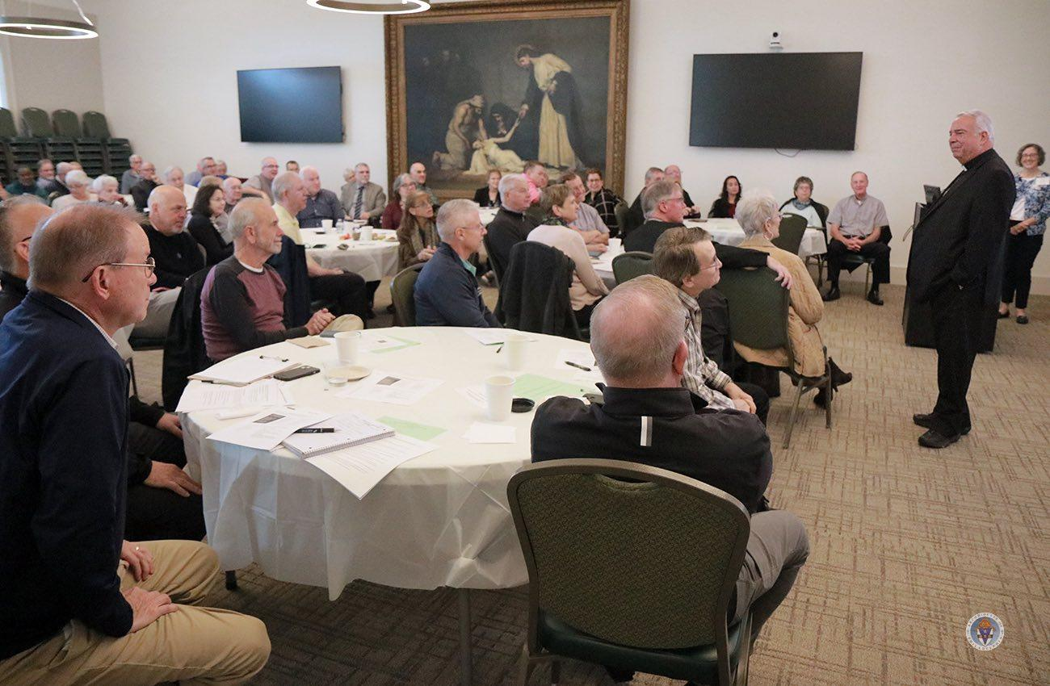


Cultural considerations
There are many reactions and various levels of receptivity to mental health issues based on beliefs, values and cultures that vary from person to person, family to family, community to community, and so on.
Notes:
Explain that MHMs exist in communities around the world, and need to keep in mind the cultural considerations of those they serve
Say, “Building your self-awareness about your reactions, thoughts, and beliefs about various aspects of mental health, including an honest acceptance of what aspects you feel most drawn toward and what aspects you are most hesitant to encounter, will be helpful.
Some folks, by heritage or lifestyle, prefer natural and holistic approaches to all health issues. It is important to acknowledge how difficult help-seeking for mental health concerns can be for people in general, but especially for those whose culture may stigmatize mental health and its treatment.

Slide 11




Lay mental health ministry motivation
If we are motivated to help to make us feel better about ourselves, or to feel better than others, then we will be of limited help to others and likely to do harm and should not enter lay ministry.
If we are motivated to help others by our love of God, then we are likely to do good and should proceed to prepare for mental health ministry.
Mental health ministers need to care for themselves in order to effectively accompany those seeking the ministry.
Our self-care includes the basics of nutrition, sleep, recreation (including getting outdoors!), time spent in healthy interpersonal relationships and of course our spiritual practices.
Notes:
Share the quotation from the CMHM Guidelines book: “Mental health ministry calls for ministers to enter into the lives of, and to walk alongside, people in some of the most challenging experiences of their lives. This ministry requires much from those who serve within it, and because of the nature of this mission, it is possible for mental health ministers to experience burnout and spiritual fatigue as a result of this work.” (From Catholic Mental Health Ministry: Guidelines for Implementation, Second Edition, 2023)
Point out the need for MHMs to serve with correct motivation. This will be a desire:
to reflect the love of Jesus to those who are suffering
to proclaim that it is good that they exist
to assure them God loves them and their gifts are valued and needed in our communities
to offer prayer and accompaniment
potentially to connect those who wish it to clinical care resources
3. Review points three and four and emphasize that self-care is not selfish. It is how we care for ourselves so we may continue to be able to serve others.

Slide 12

Talking person to person
For the person seeking or receiving mental health support it is important for them to feel seen and heard.
There is no one size fits all solution for a person dealing with mental health issues.
Effective communication with the person seeking help is crucial and can help to de-escalate a potential crisis in a safe and respectful way.
Notes:
1. Explain that communicating and engaging with others is a key skill in MHM.
2. Review point one on the slide, add “…in a non-judgmental setting. “
3. Revie point two and add, “…and each individual must be treated as such.
4. Say that this skill will be covered in more detail in other lessons of this resource, particularly in Lesson 6, but that the next slide will offer some helpful tips.

Slide 13

Helpful tips
Speak slowly and confidently with a gentle, calm and caring tone.
Don’t respond in a hostile, disciplinary or challenging manner.
It is important to remain respectful of the person’s space.
Try to calm yourself and avoid nervous behavior.
Consider taking a break from the conversation for a chance to calm down.
If the situation continues to escalate despite these attempts, consider calling for emergency services.
Notes:
Explain that there are ways we can communicate and engage that are more helpful in MHM accompaniment. Many are listed on the slide
Review point two and add, “Avoid argumentative or threatening language, as this may increase fear or prompt aggressive behavior.
Review point three and add, “As appropriate, do not restrict the person's movements. “
Review point five and add, “It is perfectly acceptable and often helpful to sit in silence with someone who is experiencing mental illness.”
and some others are:
1. Use affirmative words and phrases such as “stay calm” and “let’s collect ourselves” instead of negative words like “don’t fight” or “you need to calm down.”
2. In many cases, time, space and respectful conversation will deescalate a distressing situation.
3. Providing meaningful assistance such as offering prayerful accompaniment or assistance with referrals to mental health services are more readily received once the individual is no longer experiencing agitation or distress.
4. Remain aware that certain acts such as involving law enforcement might exacerbate the situation.

Slide 14

Suicidality and risk of harm
Acute distress may include active suicidal behavior and/or threatening behavior.
  Active suicidal behavior refers to the intention and plan for serious self harm.
  Threatening behavior refers to the intention and plan to do harm to others.
The mental health minister's role in these situations is to try to maintain the safety of themselves, the person in crisis and others that may be in the area (e.g., if the crisis is occurring during a parish event or church service).
If a person you have engaged with is in an acute state of distress you may need to call emergency services.
Notes:
Explain that some of those served in MHM may be experiencing acute distress.
Review all points on the slide.
Explain that crises such as these may occur, and we should know how to respond, but assure learners that multiple or constant crises are not typical in most MHMs.

Slide 15

Call for emergency services if
  Someone is in immediate danger of hurting themselves or others
  They are taking pills or dangerous substances, using a weapon, or threatening harm
  They are violent or suicidal
  It is not safe to, or you cannot drive yourself or the person to the emergency room
Inform the emergency service that you are calling because of a mental health emergency
Keep the person experiencing the emergency in sight, to the degree possible, until emergency services arrive
Notes:
Review the points 1 through 4 on the slide.
Review point 5 and add, “and describe the situation, including any potential threat to the health and safety of the person or others.”

Slide 16

Lesson 1 Reflection
How can lay mental health ministers effectively engage in person-to-person conversations to ensure individuals feel seen and heard in a non-judgmental setting?
How can lay mental health ministers effectively set boundaries while managing their emotional reactions, and ensuring the safety and well-being of those they serve?
Notes:
Explain that the group will now break into small groups of 4-5 learners for small group discussion of the reflection questions.
Give the small groups 5 minutes to discuss answers.
Use 5 minutes to hear some small group answers and for the facilitator to answer any questions on Lesson 1.

Slide 17
Lesson 2
RECOGNIZING THE SIGNS AND SYMPTOMS OF DEPRESSION AND ANXIETY DISORDERS
Notes:
0:25
Explain that, beginning with this lesson we will discuss the signs, symptoms and risk factors associated with depression, anxiety, schizophrenia, bipolar disorder and post-traumatic stress disorder. We focus on these disorders because they are most commonly occurring mental illnesses and mental health ministers are most likely to support parishioners with these disorders.
Explain that there are other psychiatric disorders such as personality disorders, obsessive compulsive disorders and dissociative disorders; as well as neurodevelopmental disorders such as attention deficit hyperactivity disorder and autism that certainly impact mental health. However, the inclusion of these disorders is beyond the scope of this introductory resource.
Review the title for this lesson.

Slide 18

Depression
The American Psychological Association (APA, 2018) defines depression as a negative affective state
  ranging from unhappiness and discontent to an extreme feeling of sadness, pessimism, and despondency, that interferes with daily life.
Depression can include unhappiness, sadness and generally feeling down.
These feelings are normal from time to time and by themselves do not indicate mental illness.
Notes:
Review points one, two, and three on the slide.
Say that, “When these feelings persist over along period of time without improvement, they may be considered indicative of a depressive disorder or other mental illness.
Additionally, other serious health conditions may increase risk for depression. For example, individuals with schizophrenia, cancer or heart disease often also experience depression.
Explain that risk factors for depression include genetics (ie, heredity as well as genetic vulnerabilities that may influence neurotransmitter function), personality traits, stressful events and substance abuse.

Slide 19

Anxiety
The APA defines anxiety as an emotion characterized by apprehension and somatic symptoms of tension in which an individual anticipates impending danger, catastrophe, or misfortune.
Anxiety is characterized by fear of something very bad happening. Some describe it as a feeling of impending doom.
As with depression, feeling anxious from time to time is a normal part of being human, and may be helpful.
Notes:
1. Explain that individuals experiencing depression are more likely to have an anxiety disorder. Exposure to traumatic or stressful environmental factors during childhood, including being raised by a parent with an anxiety disorder, can increase risk of developing anxiety.
2. Review points one, two and three on the slide. Add that, “For example, feeling nervous or jittery before a big athletic event or work presentation might enhance your performance.
3. Add that, when feelings of apprehension and body tension with thoughts of terrible events that might occur dominate most days, then anxiety may be considered a mental illness.
4. Explain that risk factors for anxiety include family history, experiencing trauma, stress, personality traits (such as shyness, perfectionism or low self-esteem) as well as certain medical conditions. For example, individuals with thyroid disease or heart arrhythmia may also experience anxiety secondary to their medical problems. Substance abuse can also trigger or worsen anxiety.
5. Tell learners that the next slide will offer a scenario in which a MH Minister will engage with someone who may be struggling with anxiety.

Slide 20
Lesson 2 vignette - Paul and Sam
SETTING: Parish hall after a Sunday morning meeting. A few people linger with coffee. PAUL, a man in his late 30s, sits alone at a corner table. His coffee is untouched. He's watching the room but not engaging — present in body, absent in spirit. SAM, his friend, has been watching him from across the room. He refills his own coffee and makes his way over.
SAM: Hey. Mind if I sit?
PAUL: Go ahead. (Sam sits. Doesn't rush to fill the silence. Takes a sip of coffee.)
SAM: You've been quieter lately. I've noticed it a few weeks now. Not just today.
PAUL: I'm fine. Just tired.
SAM: Yeah?
PAUL: I don't know. Everything just feels... heavy. Like it takes a lot of effort just to get here today.
SAM: How long has it felt that way?
Notes:
1. Explain that, in this scenario, continued on the next slide, Paul shows a change in behavior such as withdrawal from group activities, lack of enthusiasm, and a change ingrooming habits. Sam, one of Paul’s friends, notices and intervenes by: identifying and evaluating potential risk of harm; listening with empathy and without judgment; offering reassurance and accurate information; promoting
engagement with appropriate professional services; and supporting the use of self-help and additional support resources. Sam does not believe Paul is going through a crisis but still wants to help. Listening nonjudgmentally is important at this stage to help the person feel heard while not being judged.
2. Allow learners time to review the scenario or ask two learners to act out the two parts for the larger group.
3. Remind the learners that we are not learning to – or being asked to – diagnose someone’s mental illness. The MH Literacy we are learning is to gain knowledge about common mental illnesses, similar to the basic knowledge many of us have about common physical illnesses (heart disease, diabetes, etc.) We are also learning this content so we may better distinguish those times when it may be helpful to offer resources about clinical care in our communities.

Slide 21
Lesson 2 vignette (cont.) - Paul and Sam
PAUL: A while. A few months maybe. I kept thinking it would pass.
SAM: Has it?
PAUL: No.
SAM: I'm glad you said that. I wasn't sure if I should say anything. But I'm glad I did.
PAUL: I'm not really ready to talk about it. Not right now.
SAM: That's okay. I'm not going anywhere. (pause) And whenever you are — I'm here. And if it would help; there are people who know more about this kind of thing than I do. I can help you find someone, if you want.
PAUL: Maybe. Thanks for... I don't know. Thanks for noticing.
(Sam nods. Stays seated. They sit together in silence for a moment — not uncomfortable. Just two people, present with each other.

Slide 22

Lesson 2 Reflection
How might you respond to a parishioner who shares concerns about anxiety that is interfering with their everyday life?
How might Sam's approach to offering reassurance and resources without pressuring Paul to talk immediately contribute to a supportive environment for someone struggling with mental health issues?
Notes:
Explain that the group will now break into small groups of 4-5 learners for small group discussion of the reflection questions.
Give the small groups 5 minutes to discuss answers.
Use 5 minutes to hear some small group answers and for the facilitator to answer any questions on Lesson 2.

Slide 23
Lesson 3
RECOGNIZING THE SIGNS AND SYMPTOMS OF SCHIZOPHRENIA AND PSYCHOTIC DISORDERS
Notes:
0:40
1. Review the title of this Lesson

Slide 24

Psychosis
The American Psychological Association (2018) defines psychosis as an abnormal mental state involving significant problems with reality testing.
It is characterized by serious impairments or disruptions in the most fundamental higher brain functions—perception, cognition and cognitive processing, and emotions or affect—as manifested in behavioral phenomena, such as delusions, hallucinations, and significantly disorganized speech.
  Cognition refers to thinking while cognitive processing refers to closely related processes such as attention, reasoning, memory and judgement.
Notes:
Review the first two points on the slide.
Explain that delusions refer to rigid and highly irrational beliefs that a person clings to despite evidence to the contrary. Hallucinations are perceptions of things by any of our senses that are not actually present. The most common are visual hallucinations (ie, seeing things that aren’t there) and auditory hallucinations (ie, hearing things such as voices that aren’t there).
Add that Additionally, schizophrenia can often co-occur with substance abuse problems and depression or mania. In some cases, this combination of symptoms of schizophrenia, depressed mood and mania is diagnosed as schizoaffective disorder.
Also add that schizophrenia can also be considered a group or spectrum of related psychotic disorders that have strong familial (ie, genetic), neurophysiological and neurochemical causes.

Slide 25

Hyper-religiosity or scrupulosity
May be indicative of a psychotic disorder
Consultation with clergy and possible referral to licensed mental health professionals are often indicated in these situations
When these thoughts, behaviors and perceptions significantly alter a person's functioning and connection with reality they may be indicative of a psychotic disorder
Notes:
Explain that, while psychotic behavior is much less common than depression or anxiety, we can all think of friends, family members, clergy, teachers or other acquaintances that have unusual cognition or thinking, overly rigid or fixed beliefs and even altered perceptual experiences.
Add that any one of these behaviors or cognitions do not necessarily indicate a mental illness and may be difficult to distinguish from those who experience deep spirituality and strong devotion to the faith.
Review point three on the slide.

Slide 26

Risk factors for schizophrenia
Include genetic and family history
There is 10 percent risk of schizophrenia in individuals with at least one first degree biological relative with schizophrenia.
It is thought that a biological risk for the disorder is inherited that may be triggered by environmental or other stressors.
Stressors may include:
  pregnancy and birth complications, including maternal influenza during pregnancy
  exposure to environmental toxins
  substance abuse
Notes:
Review the top two points on the slide
Explain that there is no clear single cause for schizophrenia and current research suggests that it is likely a combination of multiple factors that trigger the diathesis.
Tell learners that the next slide will offer a scenario in which a MH Minister will engage with someone who may be struggling with schizophrenia or a psychotic disorder.

Slide 27
Lesson 3 vignette – Kate and Sarah
SETTING:
A mostly empty church, mid-morning on a weekday. Daily Mass has ended. The last parishioners have left. KATE, a woman in her mid-40s, sits alone in a front pew — still, eyes open, hands in her lap, as though waiting. She is wearing the same clothes as yesterday. Her hair is unwashed. On the pew beside her: a small stack of handwritten notes. SARAH, a parish volunteer, has been here before Kate arrived. This morning she found three of these notes tucked under the statues — one by the baptismal font, one on the altar steps, one wedged into the frame of the side door. She read them before removing them. They described an imminent warning, a specific date — the 23rd — four unnamed parishioners in the third row who must be told, and an urgent appeal addressed to the Pope. SARAH, who has known Kate for several years, approaches carefully.
Notes:
Explain that, in this scenario – continued on the next two slides - Kate has been acting differently and after talking to her you have learned that she believes she is being watched by people, hearing voices, and believes she cannot attend her prior community group meetings due to having to be ready for a secret mission she believes she must go on. You (Sarah) are concerned because Kate has started withdrawing from her friend groups and peers.
Allow learners time to review the scenario or ask two learners to act out the two parts for the larger group.

Slide 28
Lesson 3 vignette – Kate and Sarah
SARAH: Kate. Hi. I've seen you here a few mornings now. And I found your notes this morning — the ones by the font and the altar.
KATE: Good — you found them. Then you know. There isn't much time, Sarah. The 23rd is in nine days. The people in the third row need to be warned. Our Lady has been very clear: this message must go to the Holy Father. I've called the Vatican several times. I can't get through to anyone. But the time is running out.
SARAH: Tell me.
KATE: It started about two months ago. I was praying here after Mass and she came. Our Lady. She's been coming every night since then. The messages started small — just to pray more, to fast. But now they're specific. Names. Dates. Instructions. I've been writing everything down so I don't lose it. I haven't been sleeping because I don't want to miss anything. I left my job last month. This is more important.
SARAH: That sounds like a lot has changed for you. Are you sleeping?
KATE: A little. I try not to. I don't want to miss the messages. But Sarah, you have to help me. People need to know. Will you help me tell them?

Slide 29
Lesson 3 vignette (cont.) – Kate and Sarah
SARAH: Kate, I want to ask you something before we talk about that. Are you having any thoughts of hurting yourself or anyone else?
KATE: No. Of course not. This is a mission of love.
SARAH: I'm glad. Kate, I can see how much this matters to you. And I take seriously that something has been happening for you here. But I'm also seeing that you've stopped sleeping, you've left your job, you're here every morning alone. That worries me. Before anything else, I'd like you to talk to a doctor. And - would you be willing to speak with Father Michael? He knows you, and he can help you think through the next step.
KATE: You don't believe me.
SARAH: I believe that you're experiencing something very intense and very real to you. And I believe that you're exhausted and that you need support. Those two things can both be true. Will you let me walk with you to find Father Michael right now? He can hear everything you’ve told me.
KATE: (long pause, something uncertain crossing her face) Yes. Okay.

Slide 30

Lesson 3 Reflection
How can one assist when there may be signs of a psychotic disorder when hyper-religiosity and scrupulosity are present in a Catholic context?
Considering the importance of early recognition and intervention in cases of schizophrenia and psychotic disorders. How can understanding the signs and symptoms, as demonstrated in the vignette with Kate and Sarah, help in providing timely support and resources to individuals experiencing these mental health challenges?
Notes:
Use 5 minutes to hear some small group answers and for the facilitator to answer any questions on Lesson 3.

Slide 31
Lesson 4
RECOGNIZING THE SIGNS AND SYMPTOMS OF BIPOLAR DISORDERS
Notes:
0:55
1. Review the title of this Lesson.

Slide 32


Bipolar disorders
The American Psychiatric Association (2025) defines bipolar disorders as mental health conditions characterized by periodic, intense emotional states affecting a person's mood, energy, and ability to function.
These periods, lasting from days to weeks, are called mood episodes.
People with bipolar disorder generally have periods of neutral mood as well.
People without bipolar disorder also experience mood fluctuations
  but mood changes that are part of common experience typically last hours rather than days
  and are not accompanied by extreme changes in behavior or changes in functioning, such as difficulties with daily routines and social interactions
Notes:
Review the top two points on the slide
Say that, “Mood episodes are categorized as manic/hypomanic episodes when the predominant mood is intensely happy or irritable, or depressive episodes, when there is an intensely sad mood or the ability to experience joy or pleasure disappears.”
Explain that Bipolar disorder can disrupt a person’s relationships with loved ones and cause difficulty in working or going to school.
Add that, when treated, people with bipolar disorder can lead full and productive lives.

Slide 33

Bipolar I disorder
The manic episode is a period of at least one week when a person’s mood is highly elevated or irritable for a period of most days and the person is experiencing very high energy levels.
The person also has
  a decreased need for sleep
  increased or faster speech
  uncontrollable racing thoughts (or quickly changing topics when speaking)
  distractibility, increased activity and increased risk or impulsive behavior (e.g., reckless driving, spending sprees and/or sexual promiscuity)
Notes:
Explain that Bipolar I disorder is characterized by what is known as a manic episode.
Review points one and two on the slide – do not read the content shared in parentheses.
Add that, “During a severe manic episode some people may also experience psychotic symptoms such as disorganized thinking, false beliefs and or hallucinations.”
Add that a manic episode often requires hospitalization and that a person with Bipolar I disorder may also experience depressive episodes as well as periods of neutral mood.

Slide 34

Bipolar II disorder
Is characterized by a major depressive episode and at least one hypomanic episode.
Hypomanic episodes are characterized by less severe manic symptoms that last only four days in a row rather than a week.
Hypomanic symptoms do not lead to the major problems in daily life that manic episodes typically cause.
Notes:
1. Review points one and two on the slide.

Slide 35

Risk factors
The age of onset for bipolar disorders tends to be in the early 20s.
The risk of suicide is significantly higher among people with bipolar I disorder than among the general population.
Ongoing substance abuse can complicate treatment and recovery from bipolar I disorder
Other risk factors
  genetic predisposition and family history
  childhood trauma
  stressful life events and substance abuse
Notes:
Review points one, two, four, and the final point on the slide.
Add that bipolar II disorder shares similar risk factors as bipolar I disorder, but the exact cause remains unknown.
Explain that, as with each of the disorders discussed in this resource, people with bipolar I disorder frequently have other mental disorders such as anxiety disorders, substance use disorders, and/or attention-deficit/hyperactivity disorder (ADHD).
Tell learners that the next slide will offer a scenario in which a MH Minister will engage with someone who may be struggling with a bipolar disorder.

Slide 36
Lesson 4 vignette: Jane and Tina
SETTING:
Parish meeting room, after a volunteer coordination meeting. Chairs still pulled out, papers on the table. JANE is stacking chairs quickly, humming to herself, moving with more energy than the task requires. TINA lingers after the others have left. They've been friends or three years. JANE is bright, energized, fast-talking, warm, and entirely convinced she is fine.
Notes:
Explain that, in this scenario, continued on the next two slides, Tina has noticed that Jane hasn’t seemed to be her usual self lately.
Allow learners time to review the scenario or ask two learners to act out the two parts for the larger group.
Ask the learners if they are learning to – or are being asked to – diagnose someone’s mental illness. If they do not answer with an emphatic “no”, remind them that the MH Literacy we are learning is only for the purposes of:
A) gaining knowledge about common mental illnesses, similar to the basic knowledge many of us have about common physical
B) learning to better distinguish those times when it may be helpful to offer resources about clinical care in our communities.

Slide 37
Lesson 4 vignette – Tina and Jane
TINA: Hey — leave those. I wanted to catch you for a minute.
JANE: Catch me? I'm right here. Did you see how much we got done tonight? I think we can add two more events before Easter. I was thinking a retreat weekend and maybe a youth outreach — I already drafted an outline, I'll send it to you tonight.
TINA: Jane. Can you sit down for a second?
JANE: What's wrong?
TINA: Nothing's wrong. I just — I've been noticing some things, and I wanted to talk to you about them. Not to worry you. Just because I care about you.
JANE: Okay...
TINA: You've taken on four new volunteer roles since January. You've been calling people after ten at night with ideas. Maria mentioned you bought a new car last week — on the same day you saw it. And when I ask how you're sleeping, you say three or four hours but you seem fine with that.
JANE: I am fine with it. I feel great, actually. Better than I have in a long time. Isn't that allowed?

Slide 38
Lesson 4 vignette (cont.) – Tina and Jane
TINA: Of course it is. I'm glad you feel good. It's just — the combination of things. The pace. I’ve known you for three years, Jane, and this is a different gear.
JANE: So, what are you saying? That I'm too enthusiastic? That I shouldn't be taking things on?
TINA: I'm not saying you should stop anything. I'm saying I've noticed a pattern, and I think it might be worth talking to your doctor about. Just to have a conversation. That's all.
JANE: I haven't been to the doctor in a while.
TINA: Can I ask, have there been times before when you felt this way? This much energy, this much going on at once? And then afterward, a period when things got very heavy?
JANE: (quietly, after a moment) A few times. A few years back. It didn't last.
TINA: Would you be willing to mention that to a doctor? You don't have to go in with a diagnosis or an explanation. Just tell them what you told me — that this has happened before, and you want to understand it.
JANE: I'll think about it.
TINA: That's enough. Thank you for hearing me out.

Slide 39

Lesson 4 Reflection
How can one differentiate between normal mood fluctuations and the mood episodes characteristic of bipolar disorders?
Reflect on the key signs and symptoms of bipolar I and bipolar II disorders, how can recognizing these help in providing timely support and intervention?
Notes:
Explain that the group will now break into small groups of 4-5 learners for small group discussion of the reflection questions.
Give the small groups 5 minutes to discuss answers.
Use 5 minutes to hear some small group answers and for the facilitator to answer any questions on Lesson 4.

Slide 40
Lesson 5
RECOGNIZING THE SIGNS AND SYMPTOMS OF TRAUMA AND POST-TRAUMATIC STRESS DISORDERS
Notes:
1:10
1. Review the title for this lesson.

Slide 41
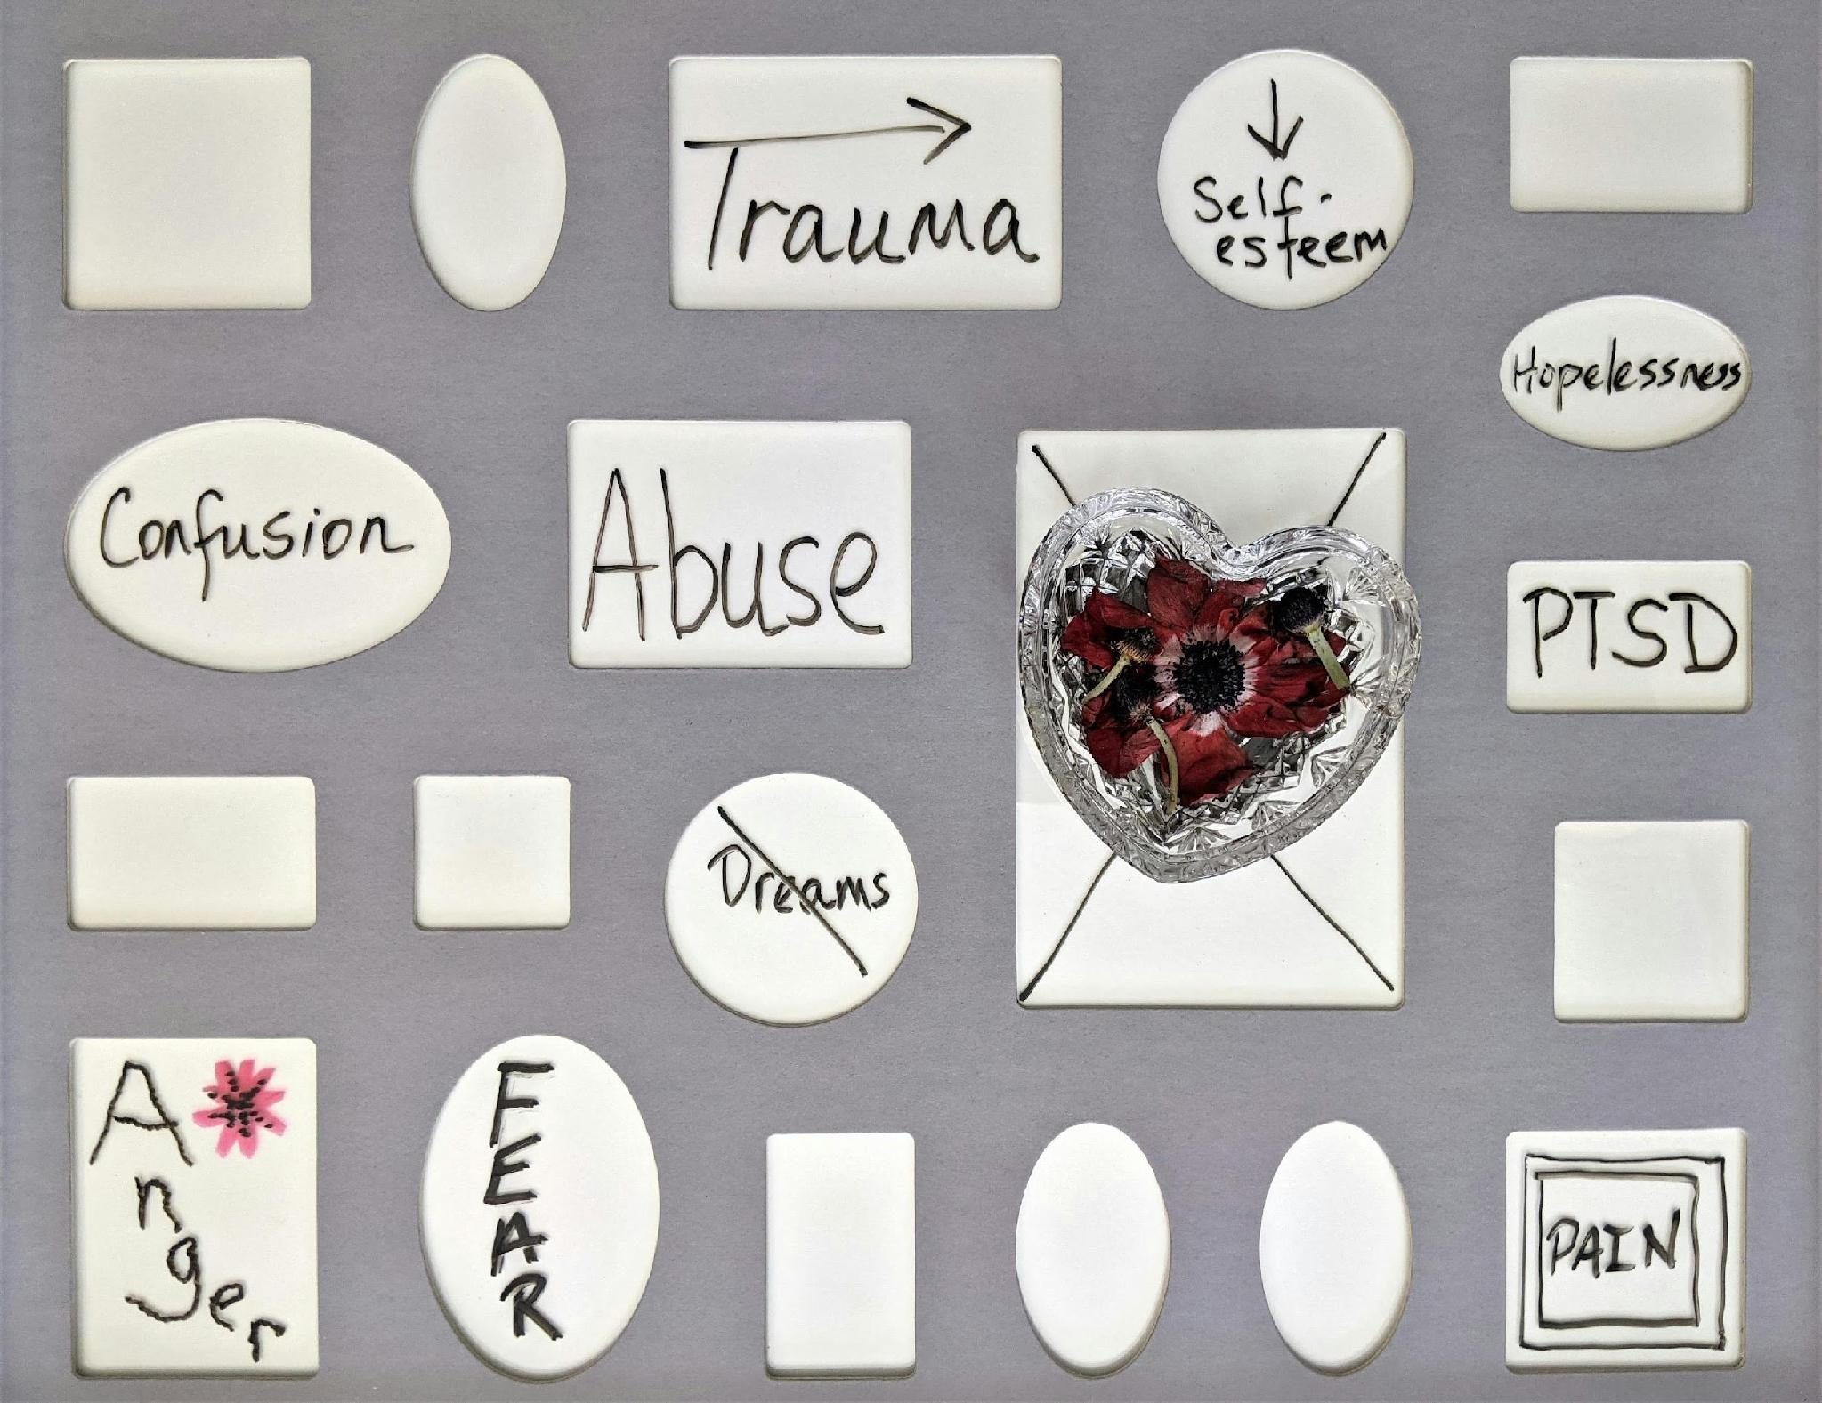
Trauma
The American Psychological Association (2025) defines trauma as:
1. any disturbing experience that results in significant fear, helplessness, dissociation, confusion, or other disruptive feelings intense enough to have a long-lasting negative effect on a person’s attitudes, behavior, and other aspects of functioning.
OR
2. any serious physical injury, such as a widespread burn or a blow to the head.
Notes:
1. Explain that the word trauma originates from a Greek word which means wound. Traumatic events include those caused by human behavior (e.g., rape, war, industrial accidents) as well as by nature (e.g., earthquakes) and often challenge an individual’s view of the world as a just, safe, and predictable place.
2. Add that, as in the second definition on the slide, this can mean a physical, bodily wound, or as in the first definition, it can also refer to a psychological wound stemming from a negative or disturbing experience. Just as we all have suffered physical traumas (i.e., cuts, bruises, burns and perhaps even broken bones or surgery) we all suffer emotional traumas. Injury and suffering is
part of life. However, when these injuries occur repeatedly, at critical development periods or sometimes at the hands of trusted adults, loved ones, or those in positions of power, the healing and recovery can be complicated and require additional support.

Slide 42

Trauma: reactions and responses
IMMEDIATE REACTIONS TO TRAUMA
DELAYED RESPONSES TO TRAUMA
numbness and detachment
anxiety or severe guilt
anger
sadness
feelings of unreality or depersonalization
feeling a loss of control
irritability or hostility
depression
mood instability
anxiety and fear
avoidance of reminders of the traumatic event
increase in high-risk behaviors as well as alcohol and substance abuse
Notes:
1. Explain that, according to the United State Substance Abuse and Mental Health Services Administration (SAMHSA, 2014), some reactions to trauma include those listed on the slide.
2. Review a few of the immediate reactions and a few of the delayed responses. Add that additional delated responses can be: social isolation or decreased activity level.
3. Add that sometimes a traumatic event may lead to a sense that the person’s life or future is curtailed or shortened.

Slide 43

Post-traumatic stress disorder (PTSD)
This disorder is characterized by
  Re-experiencing the trauma in painful recollections, flashbacks, or recurrent dreams or nightmares
  Avoidance of activities or places that recall the traumatic event
  Diminished responsiveness (emotional anesthesia or numbing)
  Disinterest in significant activities
  Feelings of detachment and estrangement from others
Notes:
Review the first two points on the slide.
Add that, “Chronic physiological arousal, leading to such symptoms as an exaggerated startle response, disturbed sleep, difficulty in concentrating or remembering, and guilt about surviving the trauma when others did not. “
Explain that when an individual witnesses or experiences a traumatic event in which they believe that there is a threat to life or physical integrity and safety and experiences fear, terror, or helplessness; a psychologist, psychiatrist or physician may diagnose post-traumatic stress disorder (PTSD).
Add that this disorder may be acute (ie, lasting less than 4 weeks), chronic or delayed (ie, occurring months or years after the event).

Slide 44
Risk factors
The primary risk factor for post-traumatic stress disorder (PTSD) is the experiencing of a traumatic event.
Other risk factors:
  A prior history of trauma, especially repeated trauma beginning in childhood.
  Other mental health conditions such as depression and anxiety.
  Social and environmental factors including lack of social support, poverty and stressful life events.
  Biological factors such as genetics, brain chemistry and sex (ie, women are somewhat more likely to develop PTSD).
  Personality traits such as neuroticism and lower intelligence.
Notes:
Review a few of the risk factors shared on the slide.
Tell learners that the next slide will offer a scenario in which a MH Minister will engage with someone who may be struggling with PTSD or other trauma-related challenges.

Slide 45
Lesson 5 vignette – Chris and Alex
SETTING:
Parish hall, after Sunday Mass, late morning. A few parishioners linger near the food table, talking. CHRIS, 30s, sits alone at a table to one side, a cup of coffee untouched in front of him. He is not disheveled, but he looks tired. ALEXIS, 40s, a parishioner who knew Chris before his military deployment, notices him from across the room and crosses to him.
Notes:
Explain that, in this scenario – continued on the next two slides - Alexis has noticed that Chris hasn’t seemed to be his usual self lately.
Allow learners time to review the scenario or ask two learners to act out the two parts for the larger group.

Slide 46
Lesson 5 vignette – Chris and Alex
ALEXIS: Chris. Mind if I sit?
CHRIS: Not at all.
ALEXIS: You’ve been coming to the early Mass lately. Slipping out before the social hour. We’ve missed you.
CHRIS: Crowds have been... a lot. Since I got back.
ALEXIS: How long has it been — about nine months now?
CHRIS: Yeah. It should be easier by now. (Across the room, someone sets down a metal tray. The clatter is sudden. CHRIS startles — hands flat on the table, shoulders up. He catches himself. A beat. He is aware Alexis noticed.)
CHRIS: Sorry.
ALEXIS: Don’t apologize. Is that happening often?
CHRIS: The nights are worse. I keep having these dreams. Sometimes it’s like I’m right back there. I wake up at three in the morning and I can’t...
ALEXIS: How long has that been going on?

Slide 47
Lesson 5 vignette (cont.) – Chris and Alex
CHRIS: A while, I don’t want to make a big thing of it. Other guys had it a lot worse.
ALEXIS: Maybe. And it still sounds like you’re really struggling.
ALEXIS: I want to ask you directly — are you having any thoughts of hurting yourself?
CHRIS: No. Nothing like that. I just — I’m tired. And I don’t know how to make it stop.
ALEXIS: I hear you. What you’re describing — the sleep, the flashbacks, pulling away from people — those are really common responses to what you went through. That doesn’t make them easy. But they’re not a sign that something is wrong with you.
CHRIS: Doesn’t feel that way.
ALEXIS: I know. I think talking to someone who specializes in exactly this would help. Not general counseling — someone trained specifically to support people who’ve been through what you’ve been through. Would you be open to that?
CHRIS: Maybe. Yeah.
ALEXIS: Good. Let’s find some time this week and we’ll figure out the right next step together. You don’t have to navigate this alone.

Slide 48

Lesson 5 Reflection
What are some normal emotional responses to trauma? What are some signs of Post-Traumatic Stress Disorder (PTSD)?
How can recognizing avoidance behaviors and diminished responsiveness help in accompaniment for individuals who have experienced trauma?
Notes:
Explain that the group will now break into small groups of 4-5 learners for small group discussion of the reflection questions.
Give the small groups 5 minutes to discuss answers.
Use 5 minutes to hear some small group answers and for the facilitator to answer any questions on Lesson 5.

Slide 49
BASIC MENTAL HEALTH LITERACY FOR ACCOMPANIMENT
1. Which of the following may be an indicator that an individual is experiencing a mental health challenge?
a. Difficulties managing the usual tasks of the day
b. Trouble maintaining focus and concentration for much of each day
c. Occasionally feeling upset about things that do not go the person’s way
d. a and b
e. a, b, and c
2. Mental Health Literacy is important for our Catholic communities because:
a. We are created mind, body, and spirit
b. Many people struggle with mental health challenges, or know others who do
c. All of the above
3. Holy people with strong faith will not struggle with mental health challenges
a. True
b. False
Please reply to the following statement with a range of 1 to 5, 1 = strongly disagree and 5 = strongly agree:
I know some basic mental health literacy, and I feel comfortable and confident when offering a listening ear or offering support and accompaniement.

Slide 50



Congratulations
You have completed Lessons 1 through 5, of the content included in CMHM’s
Basic Mental Health Literacy for Accompaniment!
Notes:
1:25
Congratulate the learners on having completed Lessons 1 through 5 of this resource.
Explain that Lesson 6 of this resource/the Handbook, the CMHM Model of Psychological First Aid (PFA), is a lengthier training focused on the practical skills helpful for offering appropriate support to someone who may be experiencing a mental health challenge.
Encourage the learners to follow this training with Lesson 6/PFA and with other resources for MHM offered by CMHM, their parish, and/or their diocese.
Thank the learners for attending this training and for their care for those in our communities who are affected by mental health challenges.

